Slide 1
Comparative Genomics and Visualisation – Part 1
Leighton Pritchard

Slide 2
Part 1
What is comparative genomics?
Levels of genome comparison
bulk, whole sequence, features
A Brief History of Comparative Genomics
experimental comparative genomics
Computational Comparative Genomics
Bulk properties
Whole genome comparisons
Part 2
Genome feature comparisons

Slide 3
What is Comparative Genomics?
The combination of genomic data and comparative and evolutionary biology to address questions of genome structure, evolution and function.

Slide 4
What is Comparative Genomics?
“Nothing in biology makes sense, except in the light of evolution”
Theodosius Dobzhansky

Slide 5
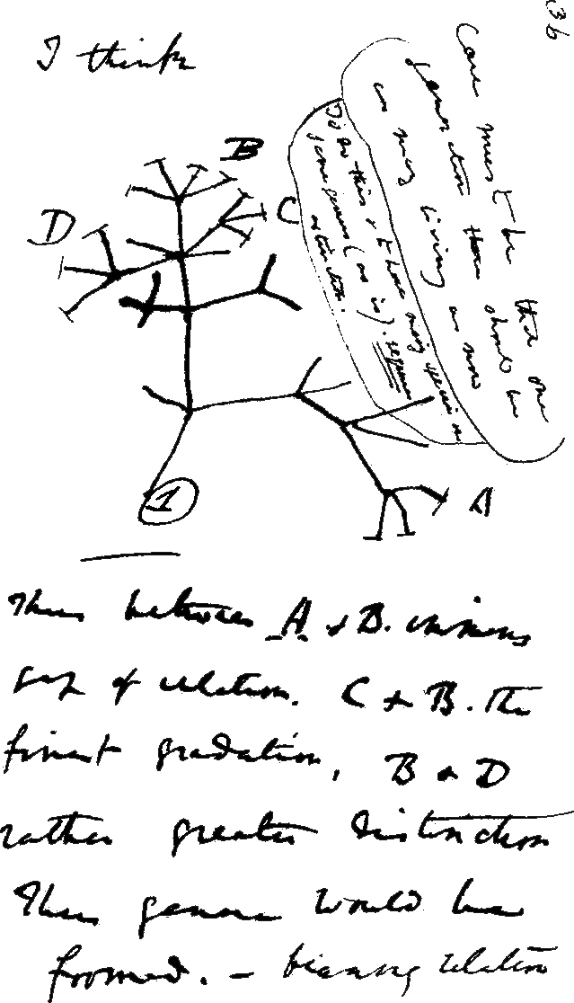
Why Comparative Genomics?
Genomes describe heritable characteristics
Related organisms share ancestral genomes
Functional elements encoded in genomes are common to related organisms
Functional understanding of model systems (E. coli, A. thaliana, D. melanogaster) can be transferred to non-model systems on the basis of genome comparisons
Genome comparisons can be informative, even for distantly-related organisms

Slide 6
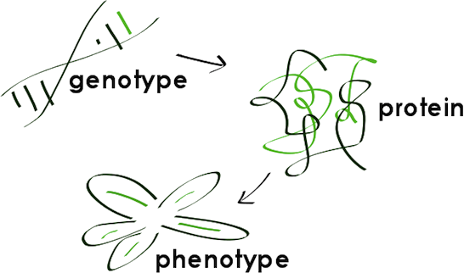
Why Comparative Genomics?
BUT:
Context: epigenetics, tissue differentiation, mesoscale systems, etc.
Phenotypic plasticity: responses to temperature, stress, environment, etc.

Slide 7
Why Comparative Genomics?
Genomic differences can underpin phenotypic (morphological or physiological) differences.
Where phenotypes or other organism-level properties are known, comparison of genomes may give mechanistic or functional insight into differences (e.g. GWAS).
Genome comparisons aid identification of functional elements on the genome.
Studying genomic changes reveals evolutionary processes and constraints.

Slide 8
Why Comparative Genomics?
time
species
contemporary organisms
Comparison within species (e.g. isolate-level – or even within individuals): which genome features may account for unique characteristics of organisms/tumours? Epigenetics in an individual.
Adapted from Hardison (2003) PLoS Biol. doi:10.1371/journal.pbio.0000058

Slide 9
Why Comparative Genomics?
time
genus
contemporary organisms
Comparison within genus (e.g. species-level): what genome features show evidence of selective pressure, and in which species?

Slide 10
Why Comparative Genomics?
subgroup
time
contemporary organisms
Comparison within subgroup (e.g. genus-level): what are the core set of genome features that define a subgroup or genus?

Slide 11
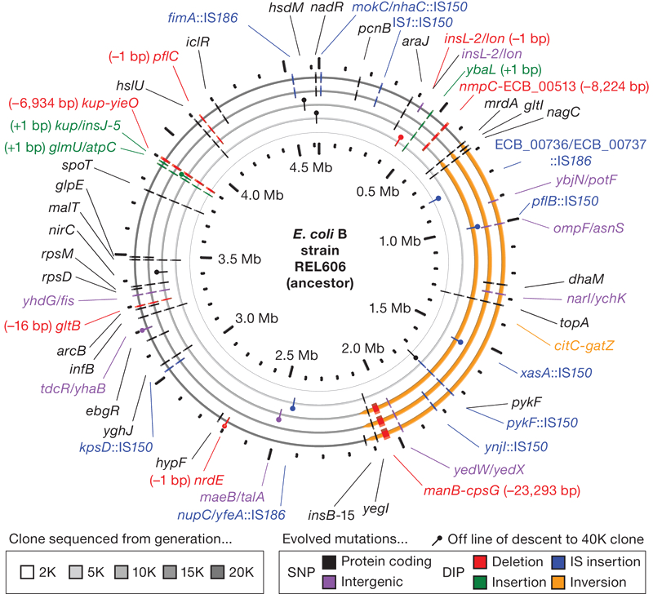
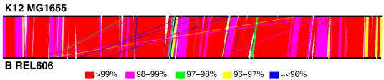
The E.coli long-term evolution experiment
Run by the Lenski lab, Michigan State University since 1988
http://myxo.css.msu.edu/ecoli/
12 flasks, citrate usage selection
50,000 generations of Escherichia coli!
Cultures propagated every day
Every 500 generations (75 days), mixed-population samples stored
Mean fitness estimated at 500 generation intervals
Jeong et al. (2009) J. Mol. Biol. doi:10.1016/j.jmb.2009.09.052
Barrick et al. (2009) Nature doi:10.1038/nature08480
Wiser et al. (2013) Science. doi:10.1126/science.1243357

Slide 12
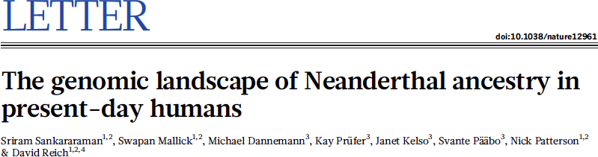
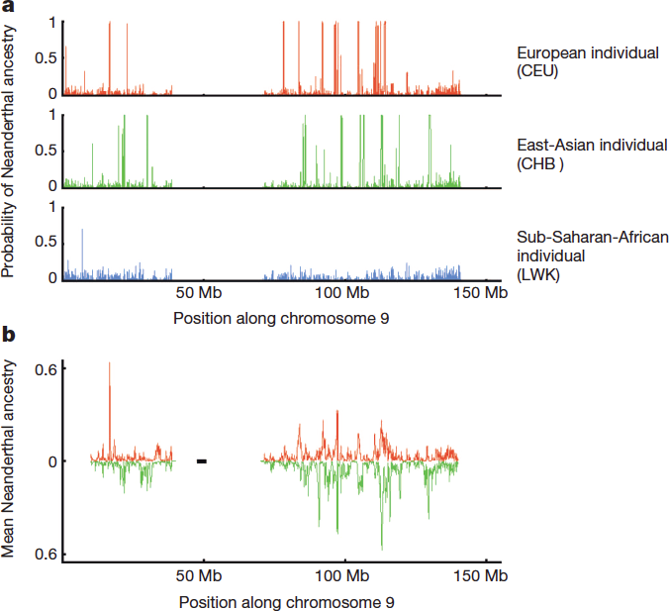
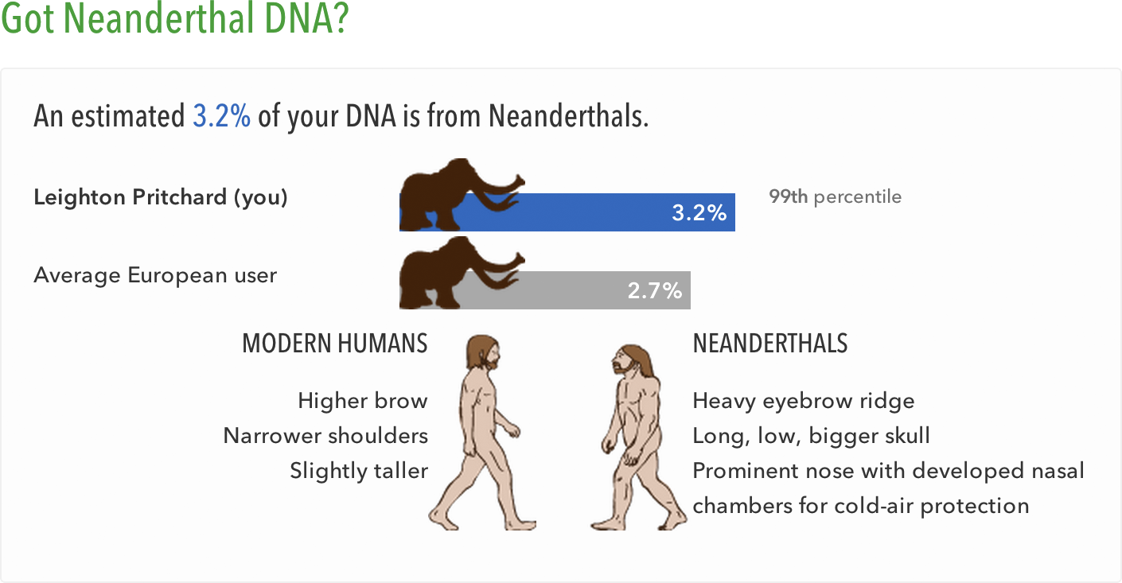
Comparative Genomics in the News
Neanderthal alleles:
Aid adaptation outwith Africa
Associated with disease risk
Reduce male fertility
Sankaraman et al. (2014) Nature. doi:10.1038/nature12961

Slide 13
Levels of Genome Comparison
Genomes are complex, and can be compared on a range of conceptual levels - both practically and in silico.

Slide 14
Three broad levels of comparison
Bulk Properties
chromosome/plasmid counts and sizes,
nucleotide content, etc.
Whole Genome Sequence
sequence similarity
organisation of genomic regions (synteny), etc.
Genome Features/Functional Components
numbers and types of features (genes, ncRNA, regulatory elements, etc.)
organisation of features (synteny, operons, regulons, etc.)
complements of features
selection pressure, etc.

Slide 15
A Brief History of Experimental Comparative Genomics
You don’t have to sequence genomes to compare them (but it helps).

Slide 16

Genome Comparisons Predate NGS
Sequence data was not always cheap and abundant
Practical, experimental genome comparisons were needed

Slide 17
Bulk Genome Property Comparisons
Values calculated for individual genomes, and subsequently compared.

Slide 18
Bulk Genome Properties
Large-scale summary measurements
Measure genomes independently – compare values later
Number of chromosomes
Ploidy
Chromosome size
Nucleotide (A, C, G, T) frequency/percentage

Slide 19
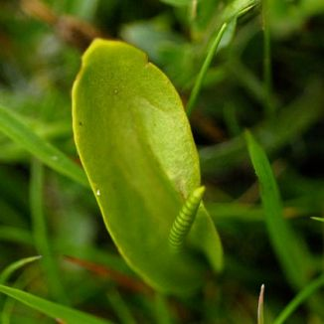
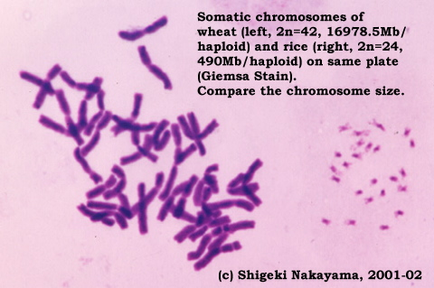
Chromosome Counts/Size
The chromosome counts/ploidy of organisms can vary widely
Escherichia coli: 1 (but plasmids…)
Rice (Oryza sativa): 24 (but mitochondria, plastids etc…)
Human (Homo sapiens): 46, diploid
Adders-tongue (Ophioglossum reticulatum): up to 1260
Domestic (but not wild) wheat somatic cells hexaploid, gametes haploid
Physical genome size (related to sequence length) can also vary greatly
Genome size and chromosome count do not indicate organism ‘complexity’
Still surprises to be found in physical study of chromosomes! (e.g. Hi-C)
Kamisugi et al. (1993) Chromosome Res. 1(3): 189-96
Wang et al. (2013) Nature Rev Genet. doi:10.1038/nrg3375

Slide 20
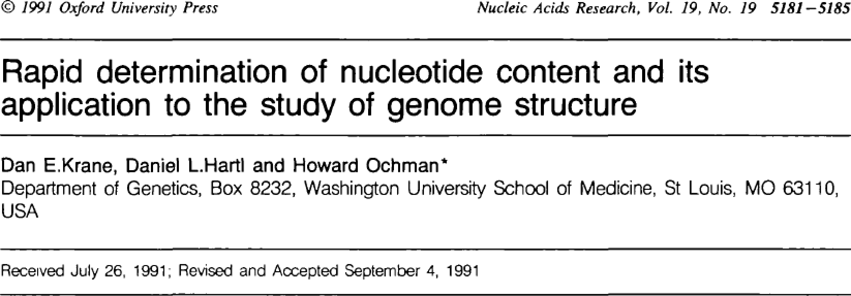
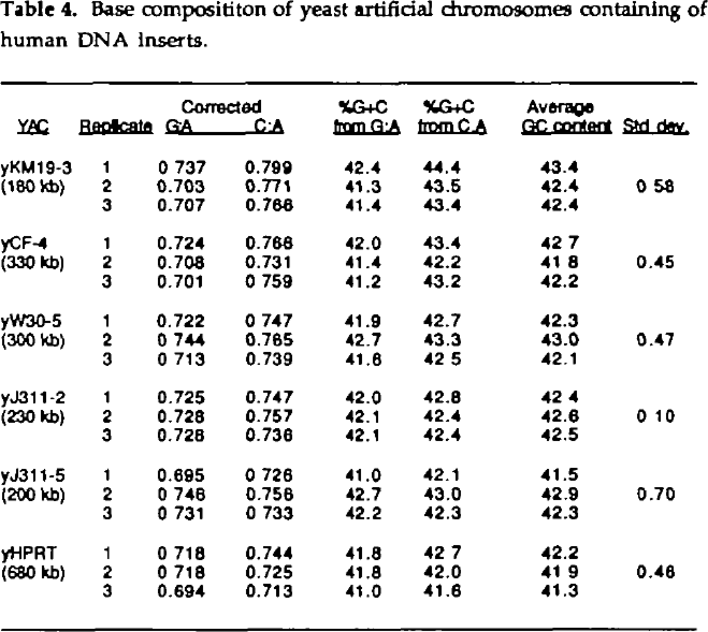
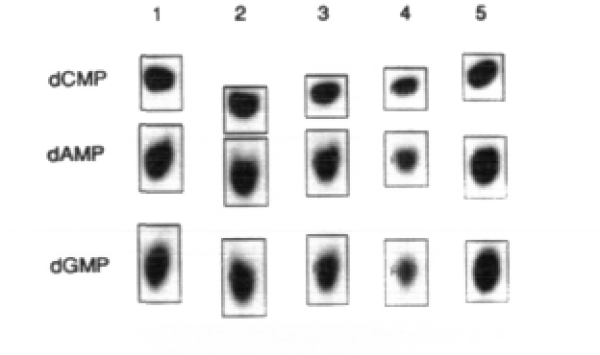
Nucleotide Content
Experimental approaches for accurate measurement
e.g. use radiolabelled monophosphates, calculate proportions using chromatography
Karl (1980) Microbiol. Rev. 44(4) 739-796
Krane et al. (1991) Nucl. Acids Res. doi:10.1093/nar/19.19.5181

Slide 21
Whole Genome Comparisons
Comparisons of one whole or draft genome with another (or many others)

Slide 22
Whole Genome Comparisons
Requires two genomes: “reference” and “comparator”
Experiment produces a comparative result, dependent on the choice of genomes
Methods mostly based around direct or indirect DNA hybridisation
DNA-DNA hybridisation
Comparative Genomic Hybridisation (CGH)
Array Comparative Genomic Hybridisation (aCGH)

Slide 23
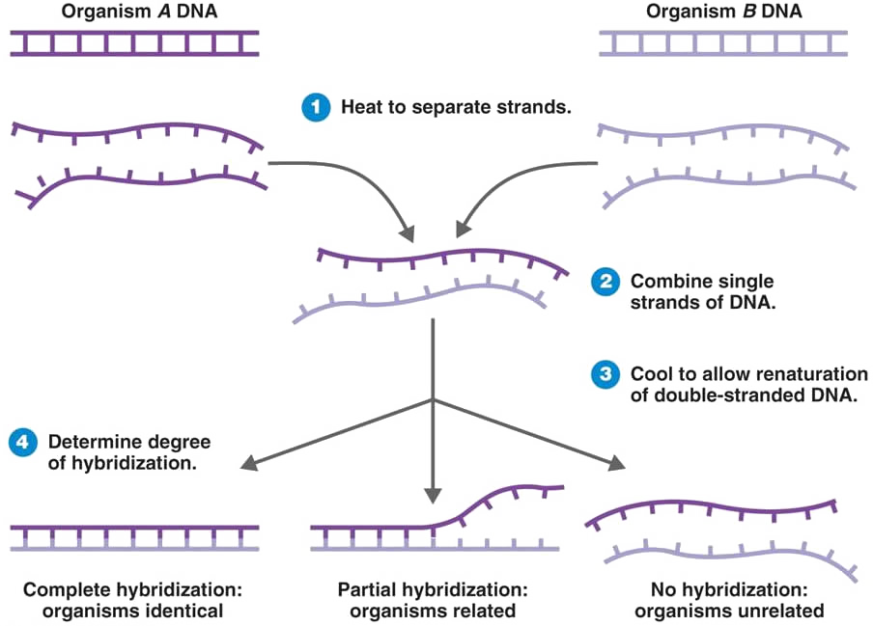
DNA-DNA Hybridisation (DDH)
Several methods based around the same principle
Denature organism A, B genomic DNA mixture
Allow to anneal – hybrids result (reassociation ≈ similarity)
Morelló-Mora & Amann (2001) FEMS Microbiol. Rev. doi:10.1016/S0168-6445(00)00040-1

Slide 24
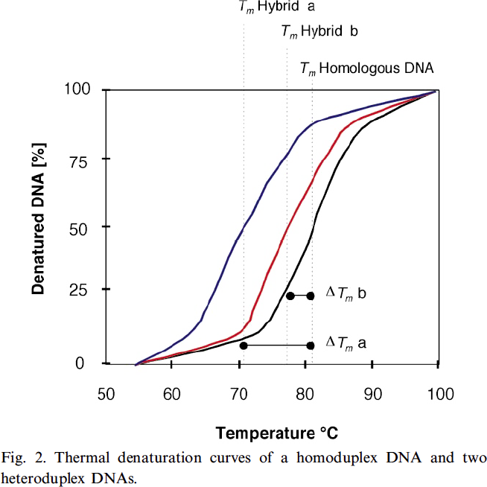
DNA-DNA Hybridisation (DDH)
Several methods - same principle
Find homoduplex Tm₁
Denature reference, comparator gDNA + mix
Allow to anneal – hybrids result (reassociation ≈ similarity), find heteroduplex Tm₂
∆Tm = Tm₁ – Tm₂
High ∆T implies greater genomic difference (fewer H-bonds)
Proxy for sequence similarity
Morelló-Mora & Amann (2001) FEMS Microbiol. Rev. doi:10.1016/S0168-6445(00)00040-1

Slide 25
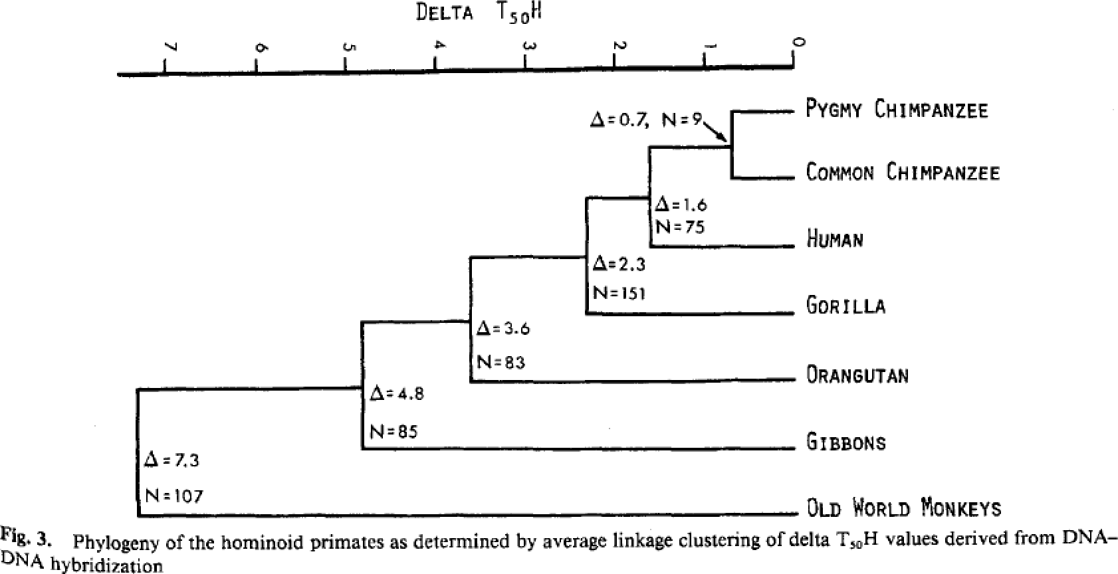
DNA-DNA Hybridisation (DDH)
Used for taxonomic classification in prokaryotes from 1960s
Sibley & Ahlquist redefined bird and primate phylogeny with DDH in 1980s: Homo shares more recent common ancestor with Pan than with Gorilla (this was previously in dispute)
Sibley & Ahlquist (1984) J. Mol. Evol. doi:10.1007/BF02101980

Slide 26
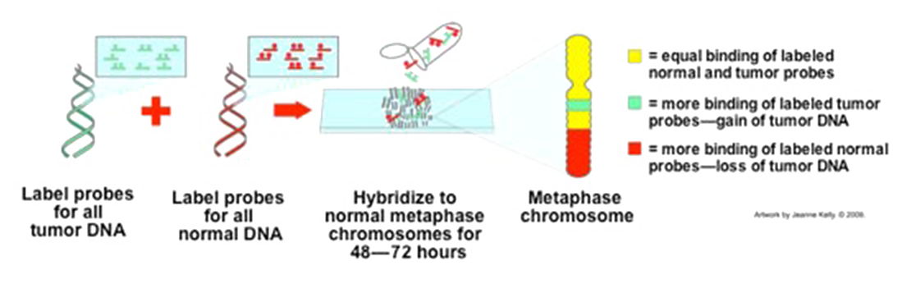
Comparative Genomic Hybridisation
Two genomes: “reference” and “test” are labelled (red and green – a bad convention to choose, for visualisation), then hybridised against a third “normal” genome
Differences in red/green intensity mapped by microscopy correspond to relative relationship of reference and test to “normal” genome
Comparisons within species (or individual, for tumours); copy number variations (CNV)
Labour-intensive, low-resolution

Slide 27
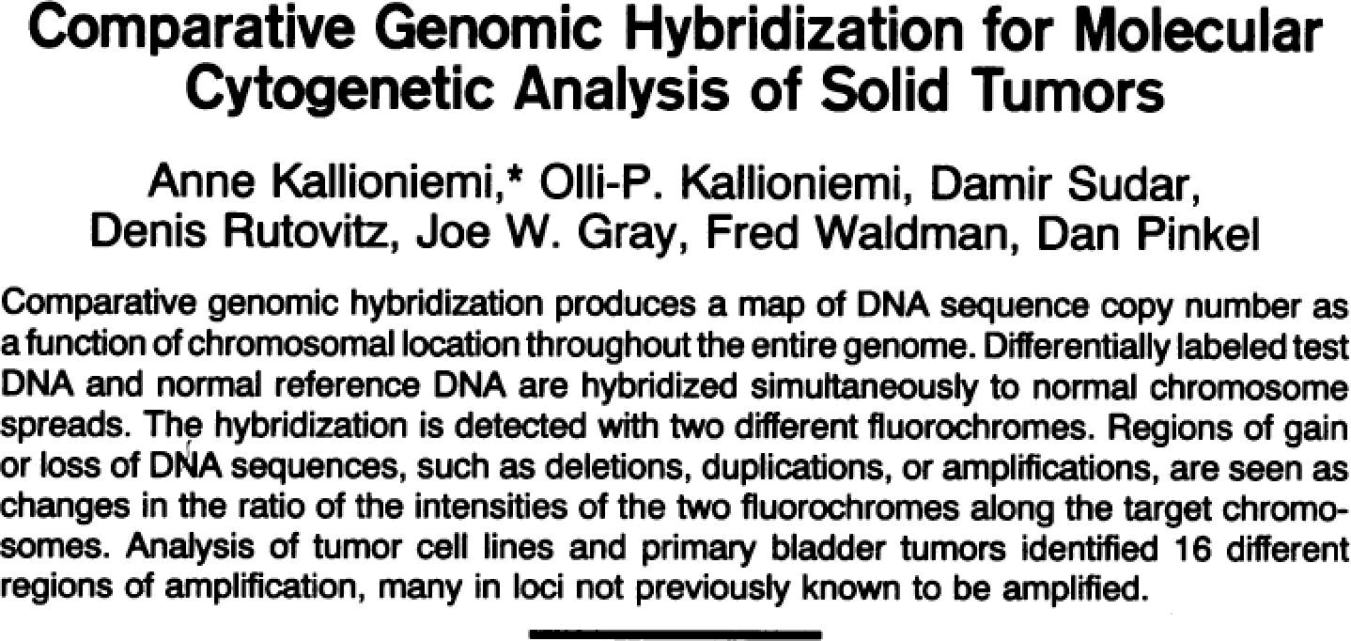
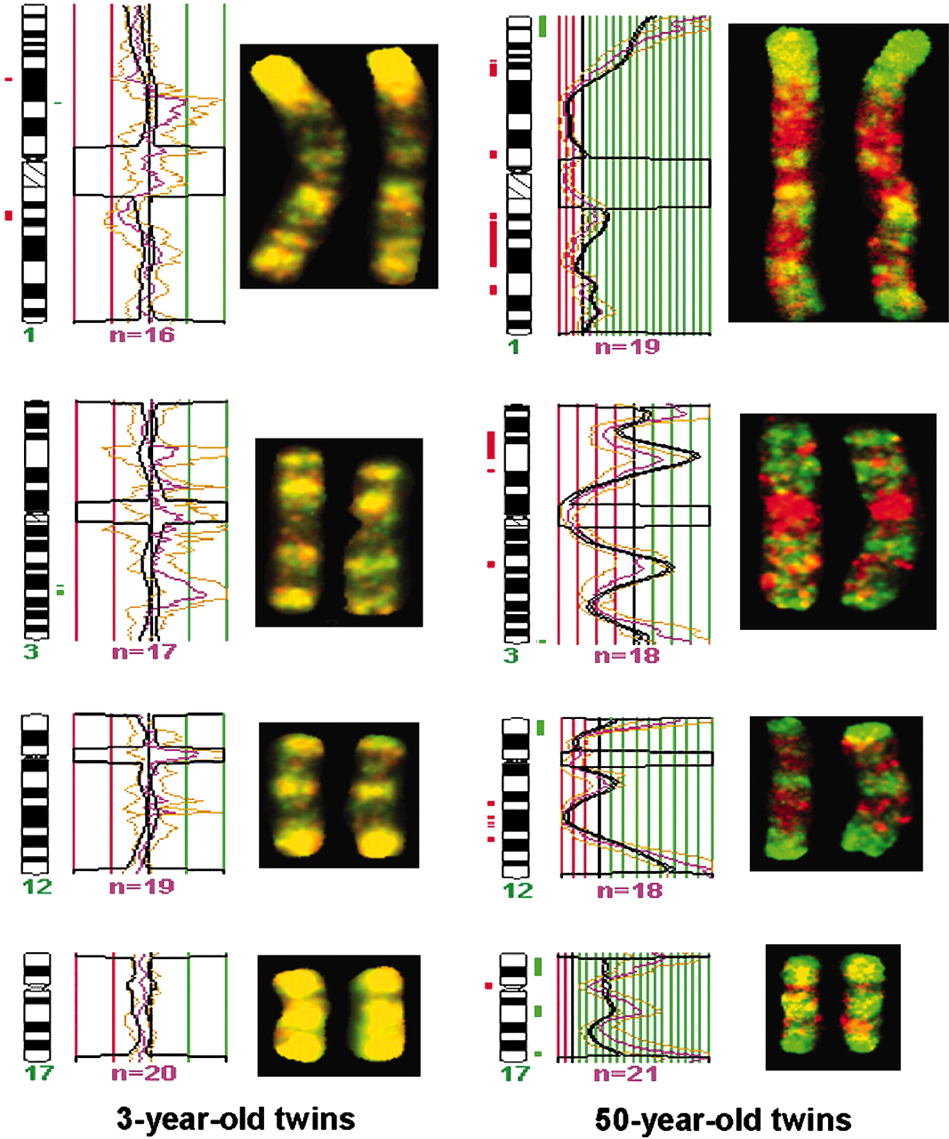
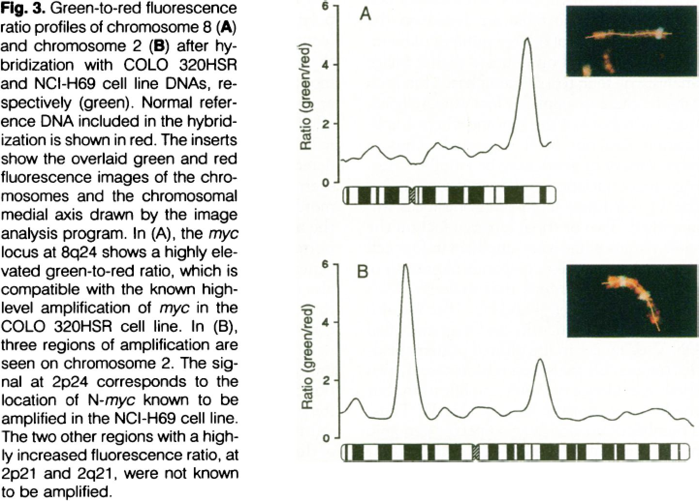
Comparative Genomic Hybridisation
Image analysis required – intensity along medial axis.
Epigenetics: hybridising methylated DNA
Kallioniemi et al. (1992) Science doi:10.1126/science.1359641 Fraga et al. (2005) Proc. Natl. Acad. Sci. USA doi:10.1073/pnas.0500398102

Slide 28
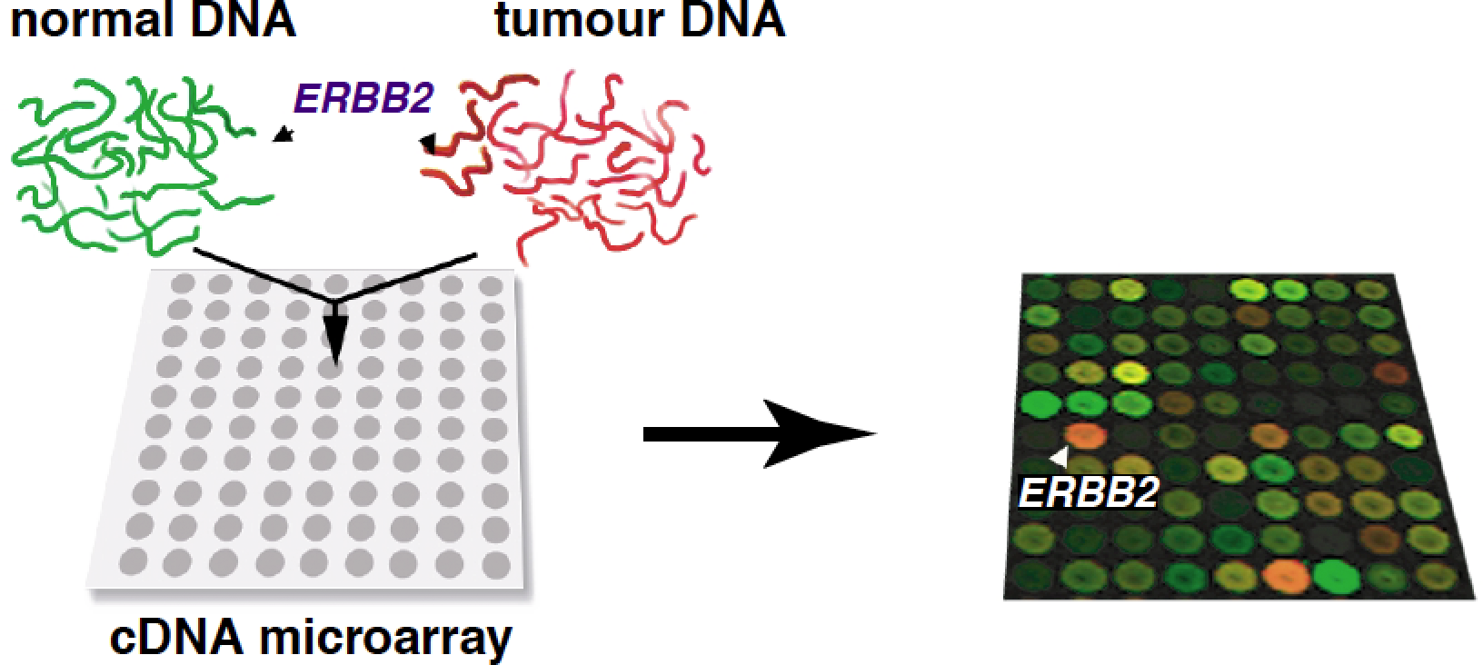
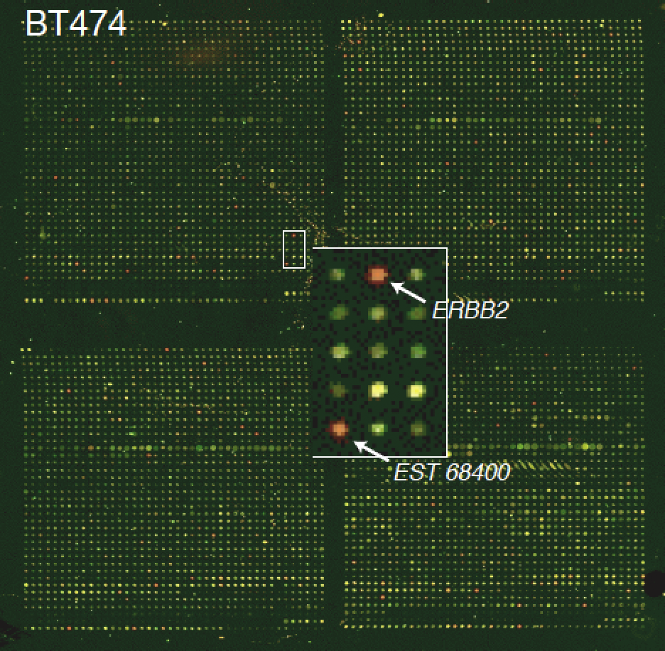
Array Comparative Genomic Hybridisation
Uses DNA microarrays: thousands of short DNA probes (genome fragments) immobilised on a surface
gDNA, cDNA, etc. fluorescently-labelled and hybridised to the array
Smaller sample sizes cf. CGH, automatable, high-throughput, high-res
Identifies copy number variation (CNV) and segmental duplication
Pollack et al. (1999) Nat. Genet. doi:10.1038/12640

Slide 29
Genome Feature Comparisons
Comparisons on the basis of a restricted set of genome features

Slide 30
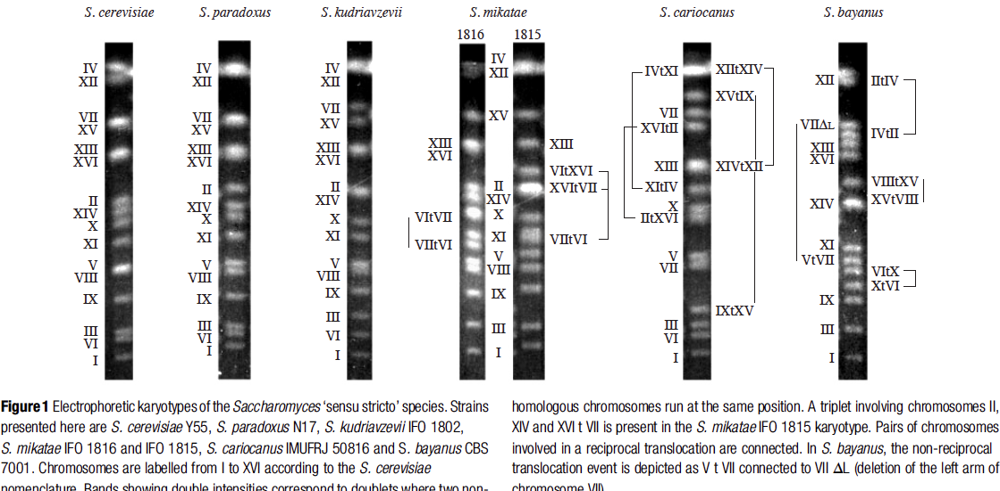
Chromosomal Rearrangements
Genomes are dynamic, and undergo large-scale changes
Hybridisation used to map genome rearrangement/duplication
Separate chromosomes electrophoretically
Apply single gene hybridising probes
Reciprocal hybridisations indicate translocations
Fischer et al. (2000) Nature. doi:10.1038/35013058

Slide 31
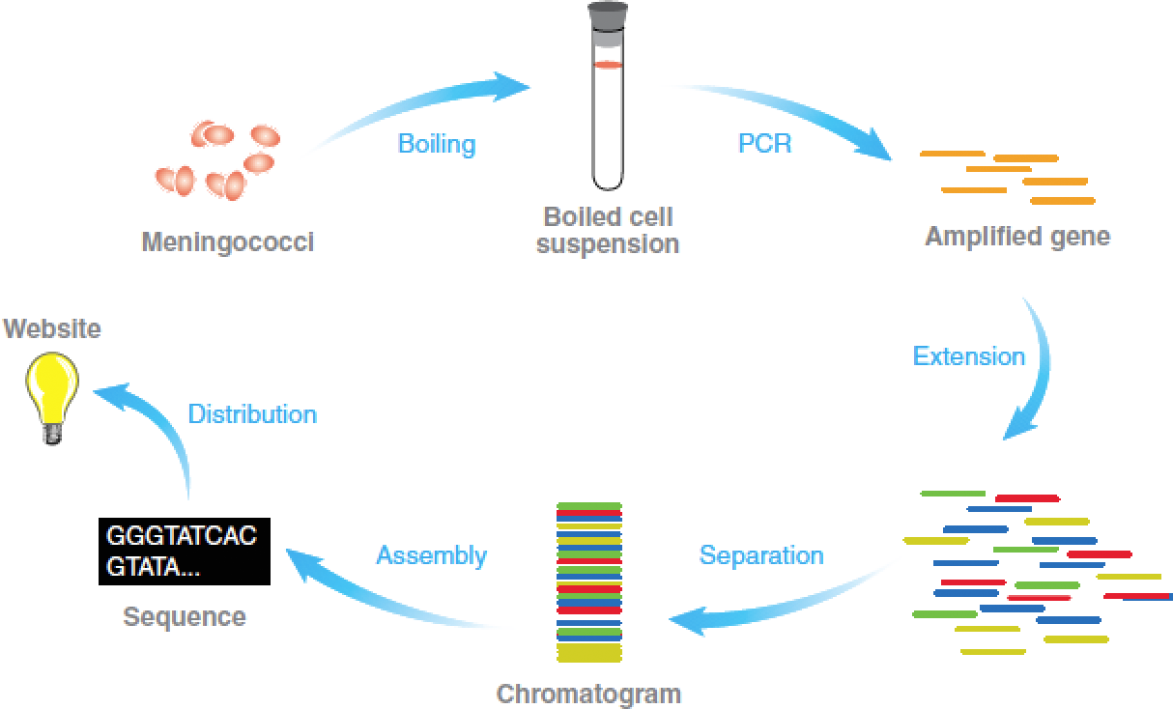
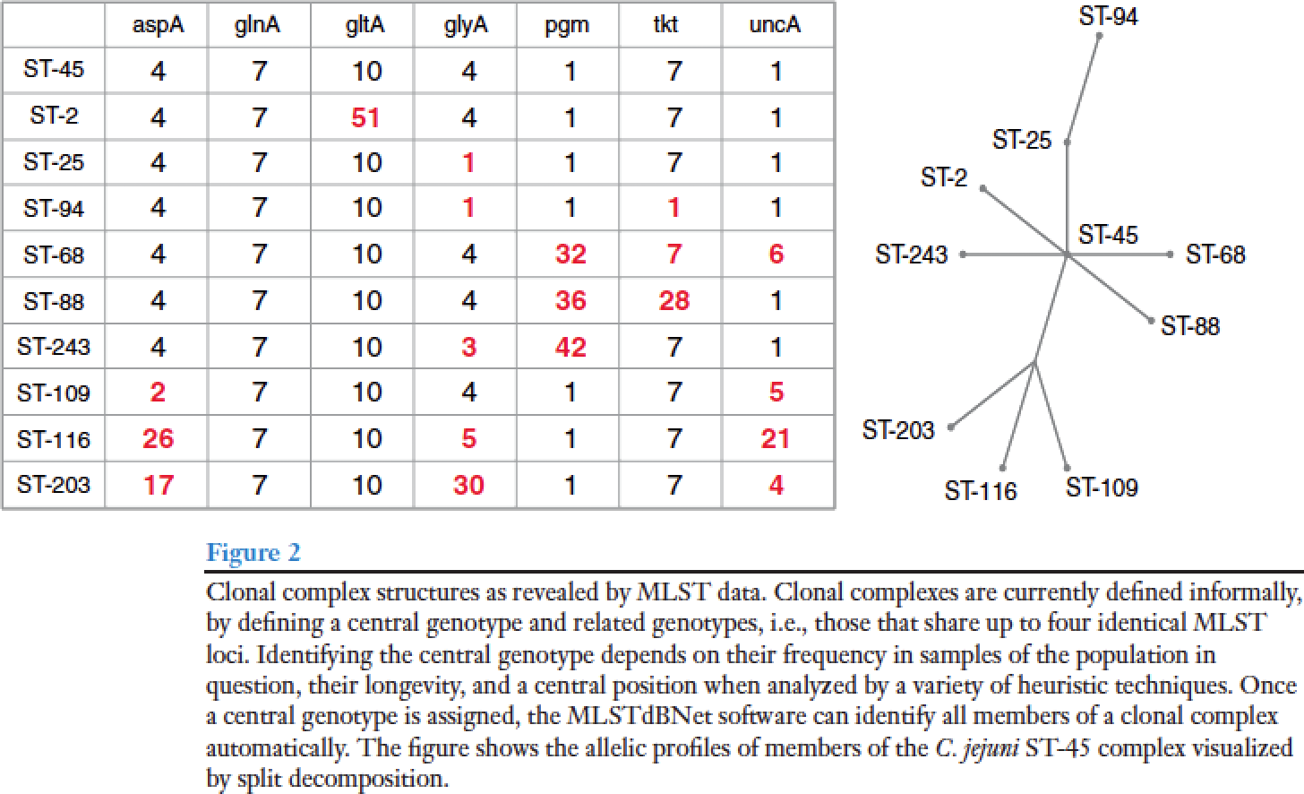
Diagnostic PCR/MLST
Define a set of regions (usually genes):
conserved enough that PCR primers can be designed to amplify the same region in multiple organisms
and:
divergent enough that hybridising probes can distinguish between groups
or:
sequence the amplification products
Sequence variants given numbers
Number profiles define groups
Track evolution by minimum spanning trees (MST)
http://pubmlst.org/
Maiden et al. (2006) Ann. Rev. Microbiol. doi:10.1146/annurev.micro.59.030804.121325

Slide 32
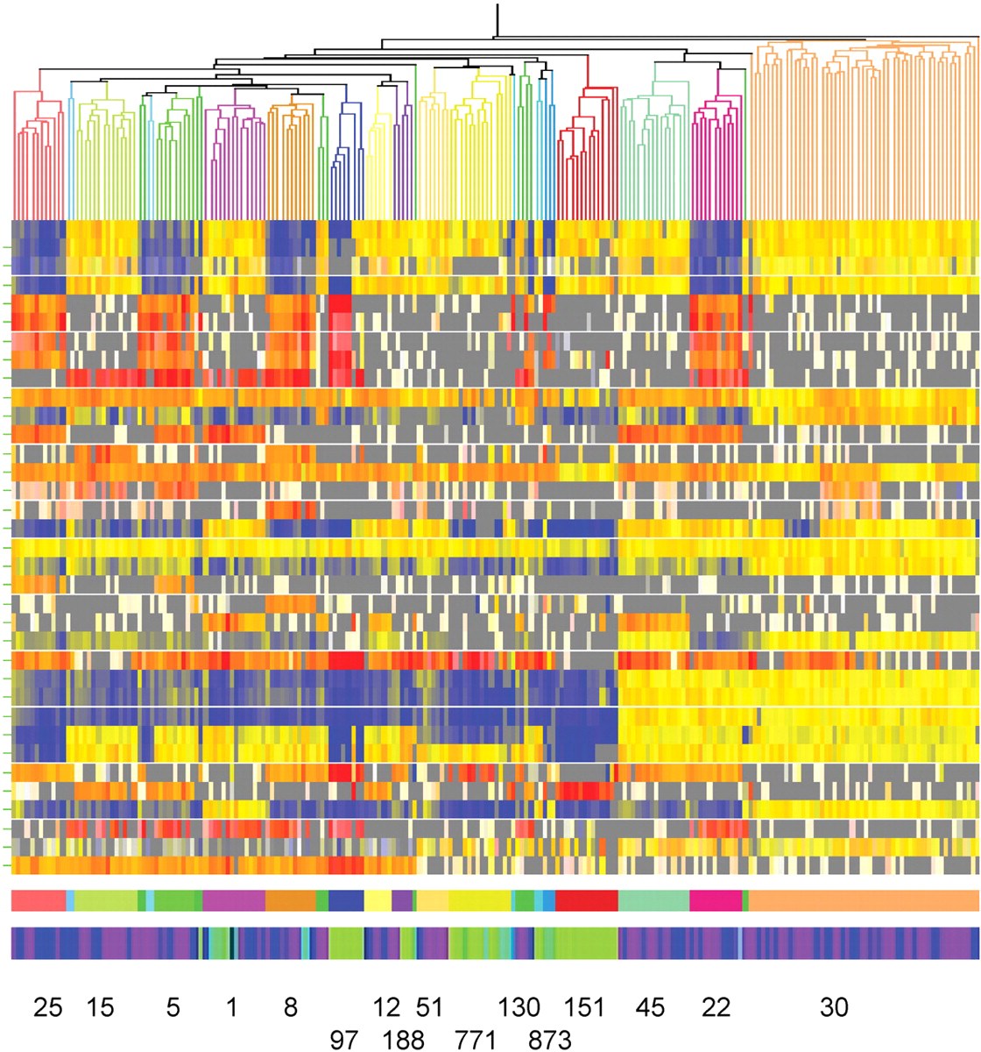
Array Comparative Genomic Hybridisation
aCGH can also be applied across species for classification/diagnostics:
Microarray probes represent genes from one or more organisms
“Off-species” gDNA fragmented, labelled, and hybridised
Hybridisation ≈ sequence similarity ≈ gene presence
Heatmap of 217 Staphylococcus aureus isolates on 7-strain array.
columns=isolates
yellow/red=gene present
blue/white/grey=gene absent
Lower bars coloured by lineage and host (green=cattle, blue=horse, purple=human)
Sung et al. (2008) Microbiol. doi:10.1099/mic.0.2007/015289-0

Slide 33
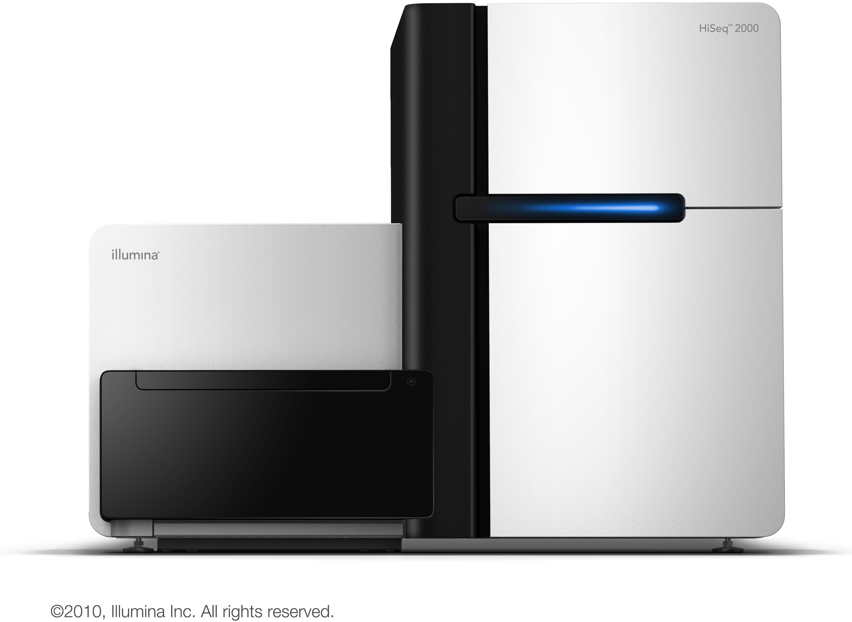
But This Happened…
High-throughput sequencing

Slide 34
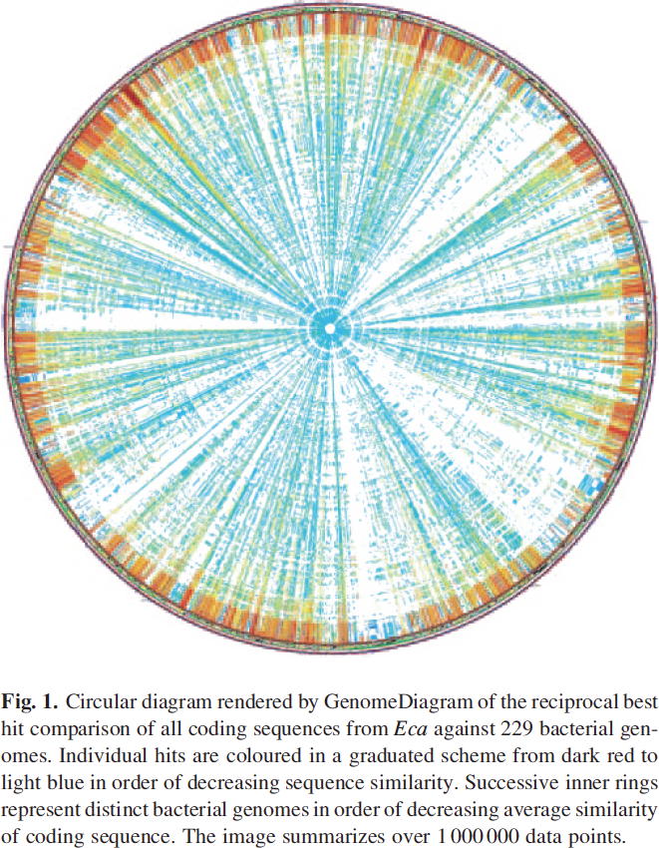
…And Then It Rained Sequence Data
Modern high-throughput sequencing (454, Illumina) completely changed the landscape.
Complete, (mainly) accurate sequence data much cheaper, enabling:
more precise sequence comparison
novel analyses, insights and visualisations
Genomic & exomic comparisons
19/2/2014 at GOLD:
3,011 “finished” genomes
9,891 “permanent draft” genomes
19/2/2014 at NCBI WGS:
17,023 whole genome projects

Slide 35
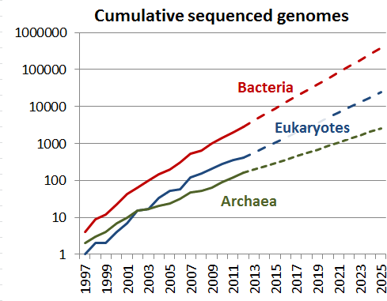
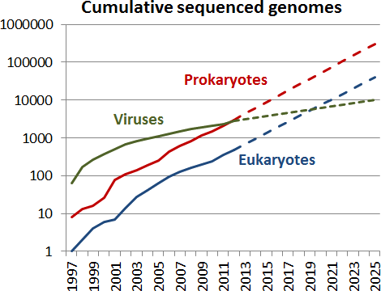
…And Then It Rained Sequence Data
In 2012, GOLD added 3736 genomes, NCBI added 4585
Mostly prokaryotes (archaea and bacteria)
We’re a little ahead of Su’s (Scripps, La Jolla) projections
Figures and code from: http://sulab.org/2013/06/sequenced-genomes-per-year/

Slide 36
Computational Comparative Genomics
Massively enabled by high-throughput sequencing, much more powerful and precise.

Slide 37
Three broad levels of comparison
Bulk Properties
chromosome/plasmid counts and sizes,
nucleotide content, etc.
Whole Genome Sequence
sequence similarity
organisation of genomic regions (rearrangements), etc.
Genome Features/Functional Components
numbers and types of features (genes, ncRNA, regulatory elements, etc.)
organisation of features (synteny, operons, regulons, etc.)
complements of features
selection pressure, etc.

Slide 38
Bulk Genome Property Comparisons
Values calculated for individual genomes, and subsequently compared.

Slide 39
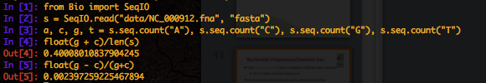
Nucleotide Frequencies/Genome Size
Very easy to calculate from complete or draft genome sequence
(or in a region of genome sequence)
GC content/chromosome size can be characteristic of an organism
[ACTIVITY]
bacteria_size_gc iPython notebook
ipython notebook –-pylab inline in bacteria_size directory

Slide 40
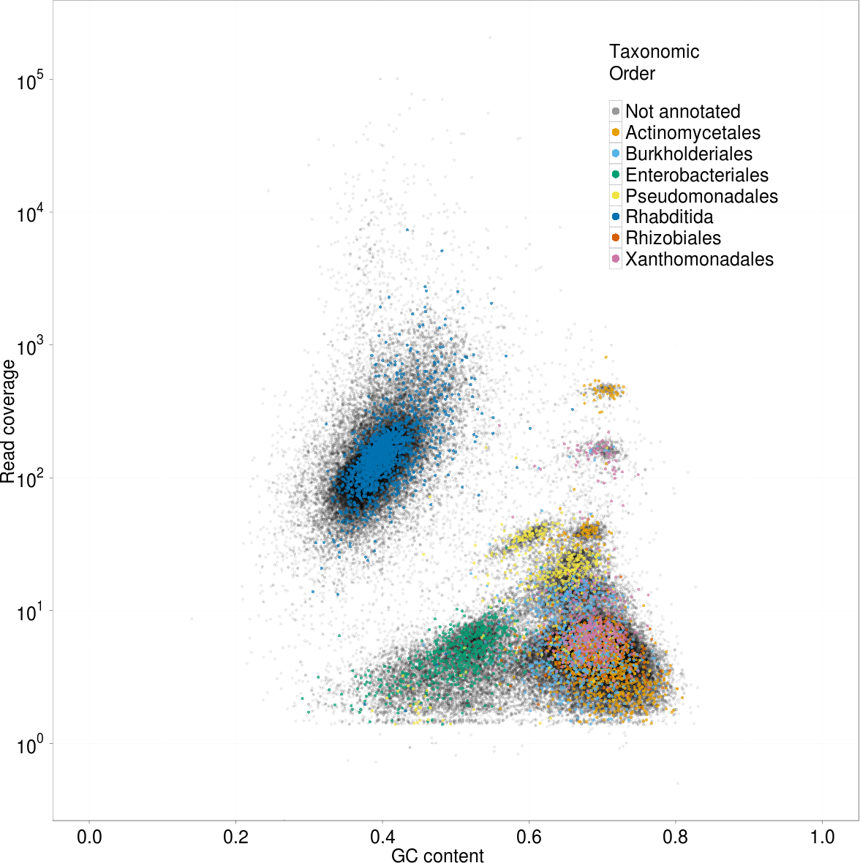
Blobology
Metazoan sequence data can be contaminated by microbial symbionts.
Host and symbiont DNA have different %GC (and are present in different amounts/coverage)
Preliminary genome assembly, followed by read mapping
Plot contig coverage against %GC = Blobology
http://nematodes.org/bioinformatics/blobology/
Kumar & Blaxter (2011) Symbiosis doi:10.1007/s13199-012-0154-6

Slide 41
Nucleotide k-mers
Sequence data is required to determine k-mers
Nucleotide frequencies:
A, C, G, T
Dinucleotide frequencies:
AA, AC, AG, AT, CA, CC, CG, CT, GA, GC, GG, GT, TA, TC, TG, TT
Trinucleotide frequencies:
64 trinucleotides
k-nucleotide frequencies:
4^{k} k-mers
[ACTIVITY]
runApp(“shiny/nucleotide_frequencies”)in RStudio

Slide 42
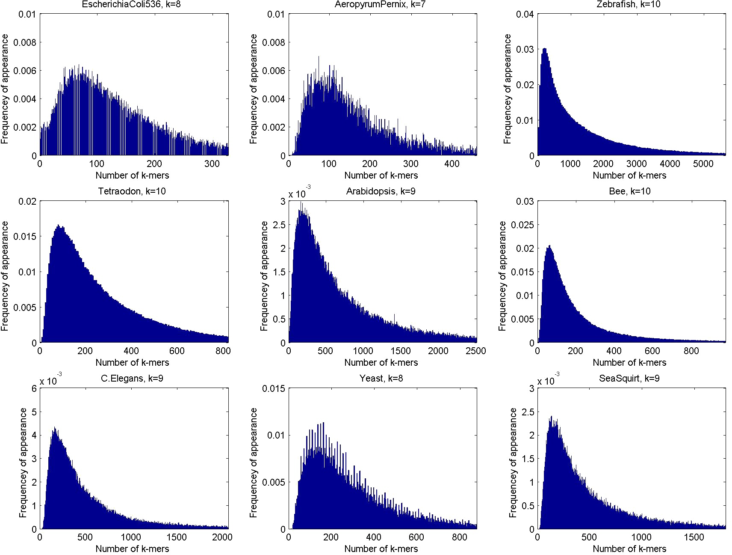
k-mer Spectra
k-mer spectrum:
Frequency distribution of observed k-mer counts
Most species have a unimodal k-mer spectrum
Chor et al. (2009) Genome Biol. doi:10.1186/gb-2009-10-10-r108

Slide 43
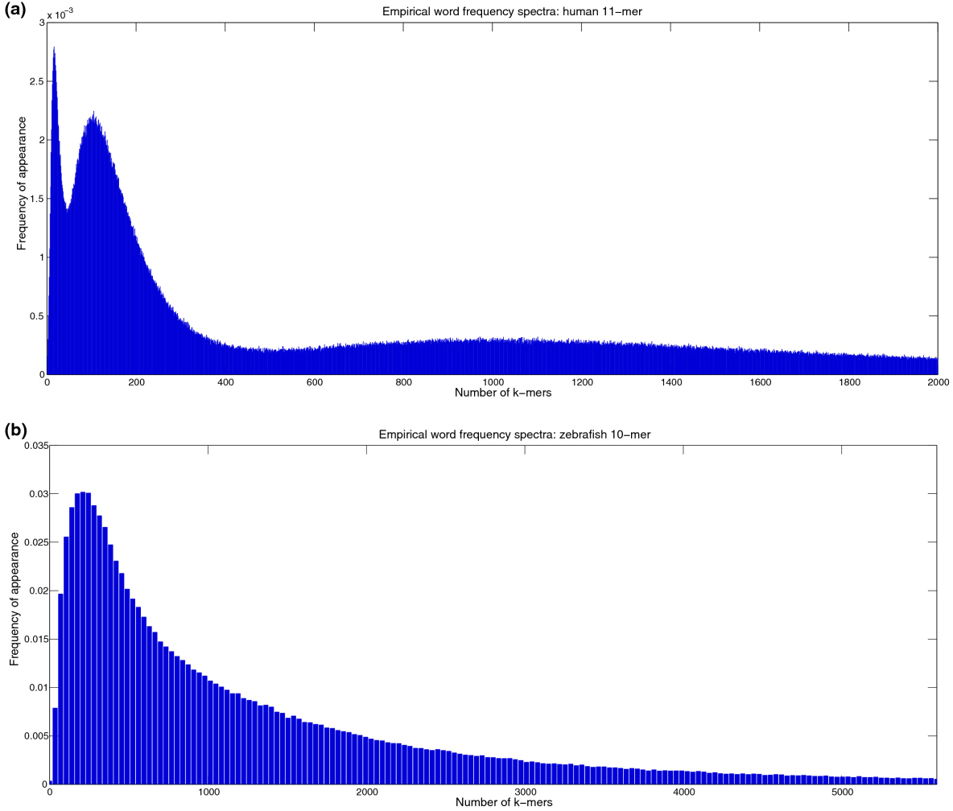
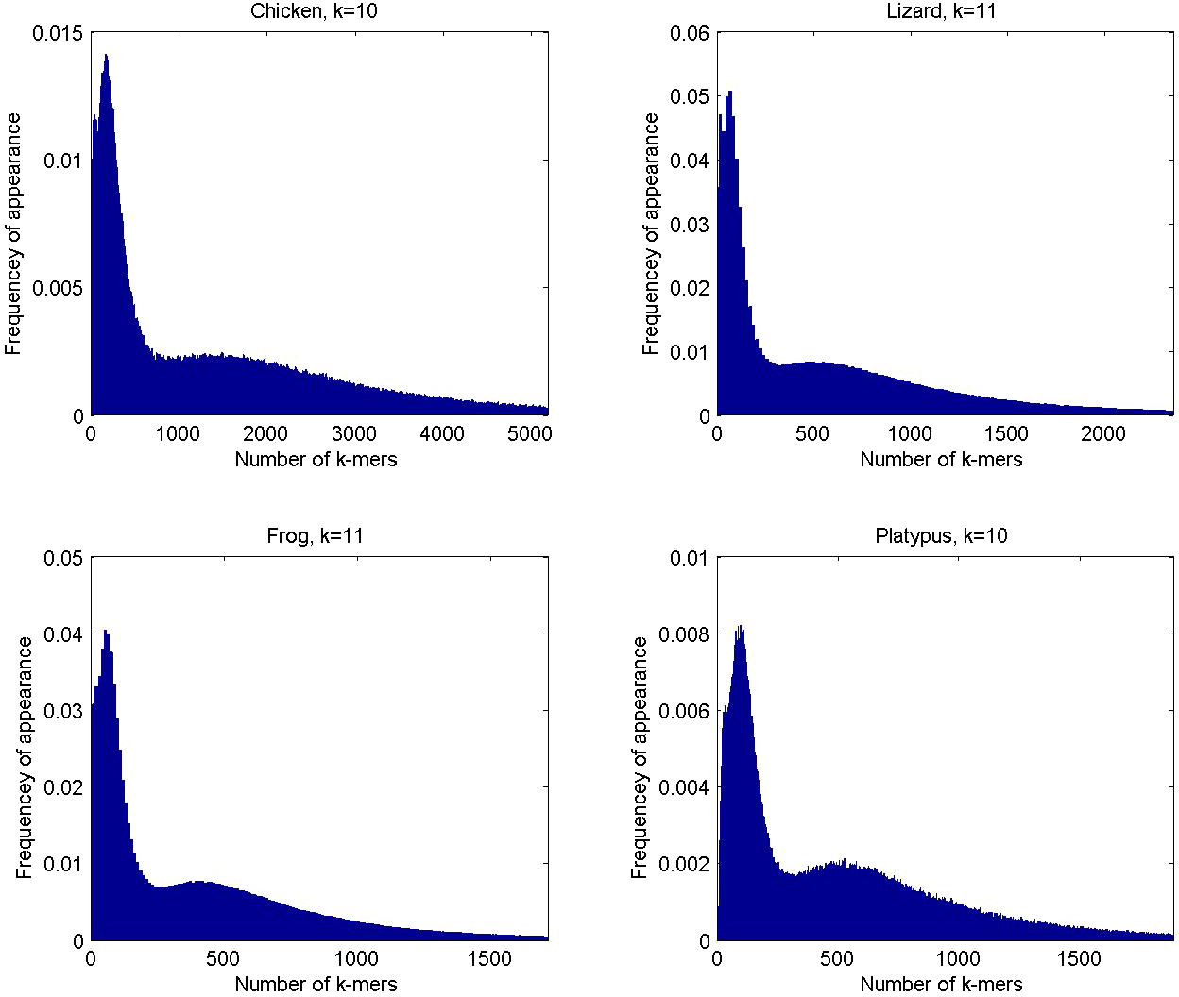
k-mer Spectra
k-mer spectrum:
All mammals tested (and some other) species have a multimodal k-mer spectrum
Genomic regions differ in this property
Chor et al. (2009) Genome Biol. doi:10.1186/gb-2009-10-10-r108

Slide 44
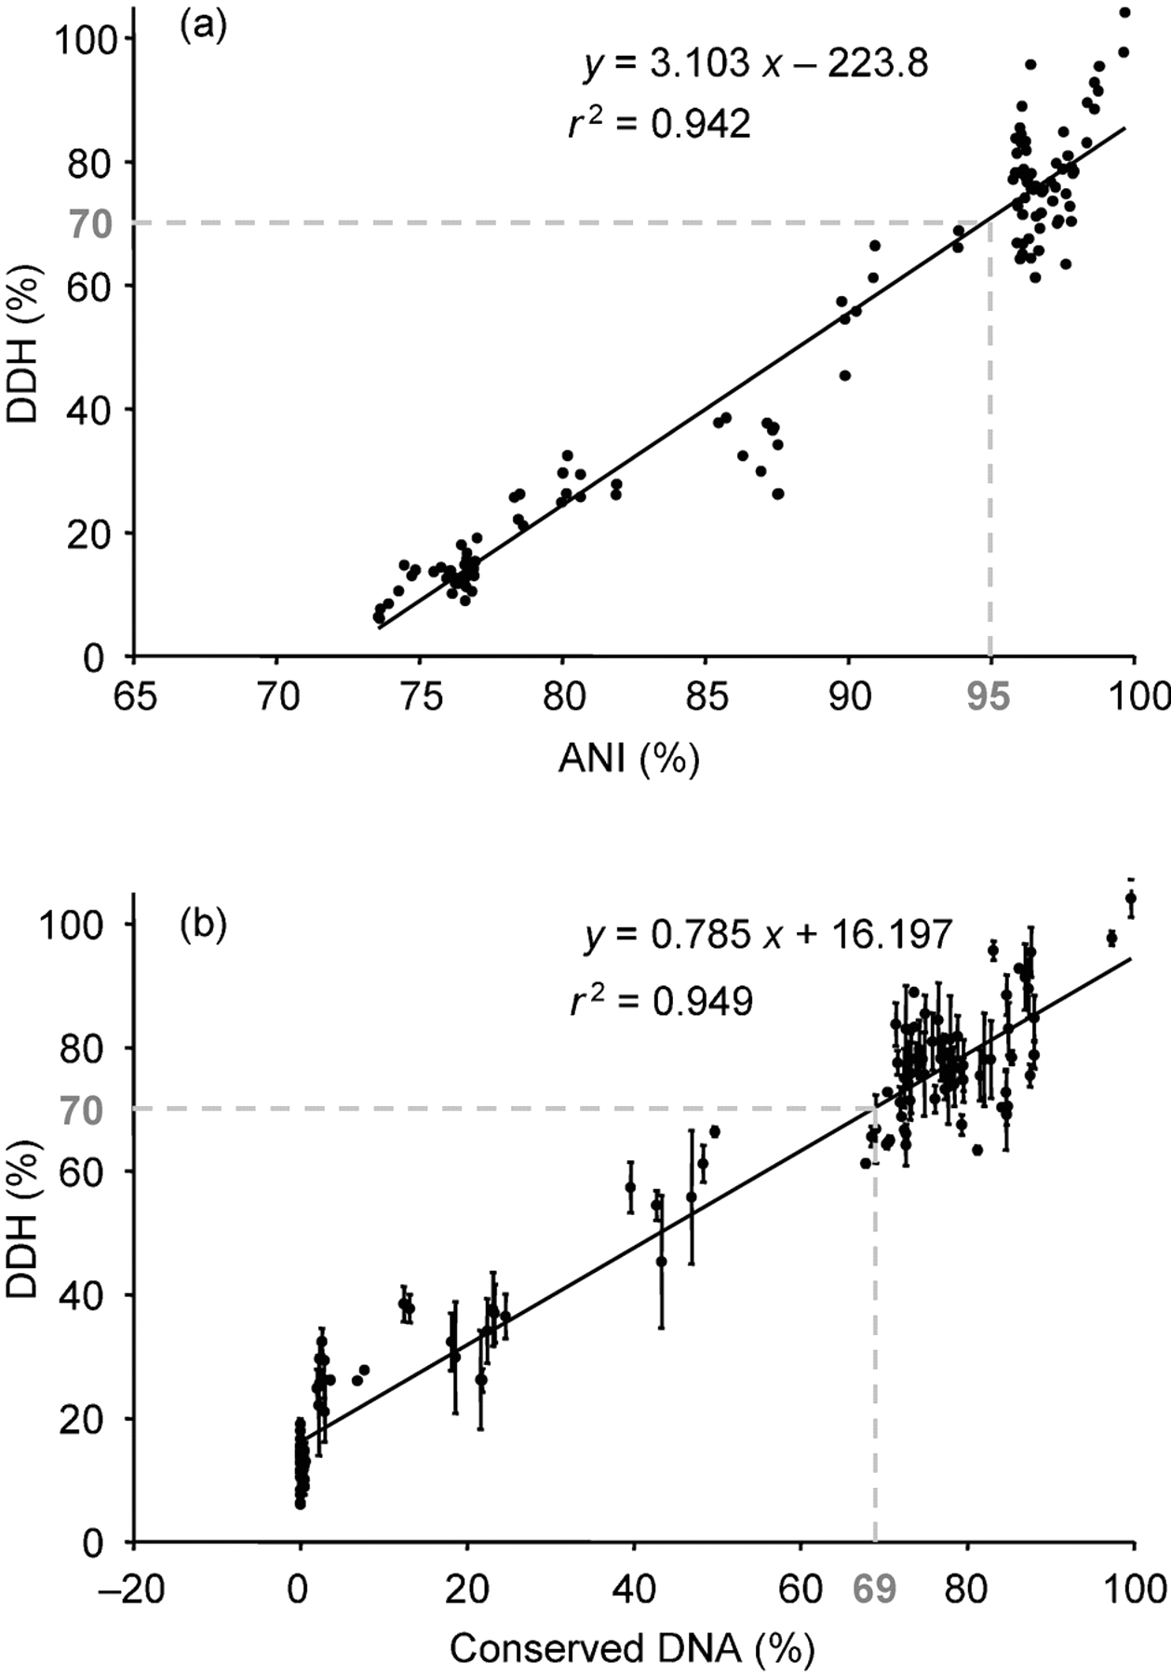
Average Nucleotide Identity (ANI)
ANI introduced as a substitute for DDH in 2007:
70% identity (DDH) = “gold standard” prokaryotic species boundary
70% identity (DDH) ≈ 95% identity (ANI)
Goris et al. (2007) Int. J. System. Evol. Biol. doi:10.1099/ijs.0.64483-0

Slide 45
Average Nucleotide Identity (ANI)
ANI introduced as a substitute for DDH in 2007:
70% identity (DDH) = “gold standard” prokaryotic species boundary
70% identity (DDH) ≈ 95% identity (ANI)
Original method emulates physical experiment:
break genome into 1020nt fragments
align fragments using BLASTN
ANI = mean identity of all BLASTN matches with >30% identity over 70% alignable length
Goris et al. (2007) Int. J. System. Evol. Biol. doi:10.1099/ijs.0.64483-0

Slide 46
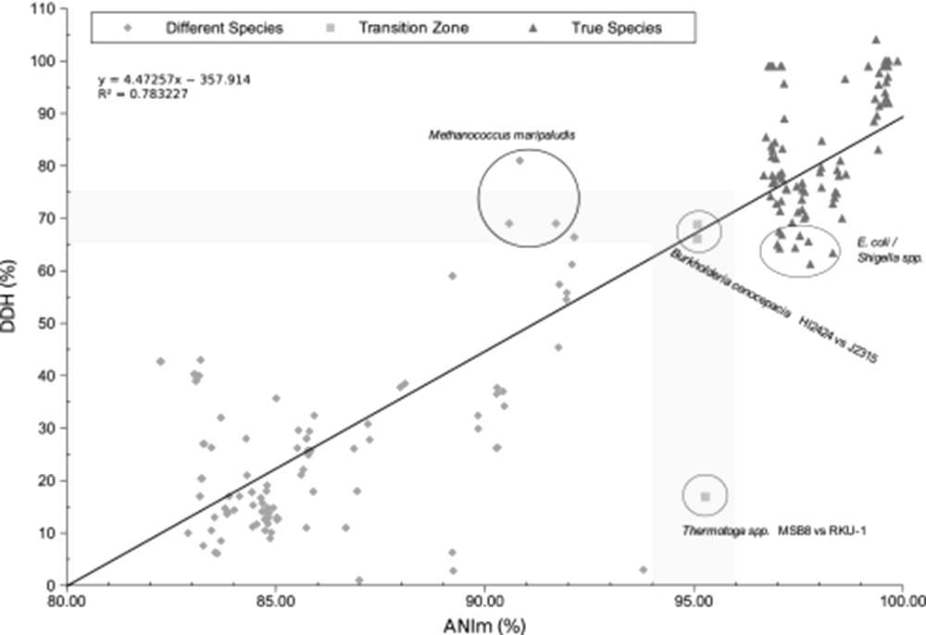
Average Nucleotide Identity (ANI)
ANI introduced as a substitute for DDH in 2007:
70% identity (DDH) = “gold standard” prokaryotic species boundary
70% identity (DDH) ≈ 95% identity (ANI)
ANIm and TETRA introduced (2009)
Align sequences using NUCmer
ANI = mean %identity of matches
TETRA:
Calculate tetranucleotide frequencies
Determine each tetramer deviation from expectation (Z-score)
TETRA = Pearson correlation coefficient of tetramer Z-scores
Richter & Rosselló-Móra (2009) Proc. Natl. Acad. Sci. USA doi:10.1073/pnas.0906412106

Slide 47
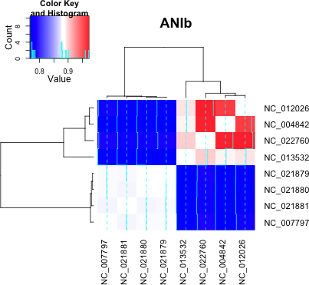
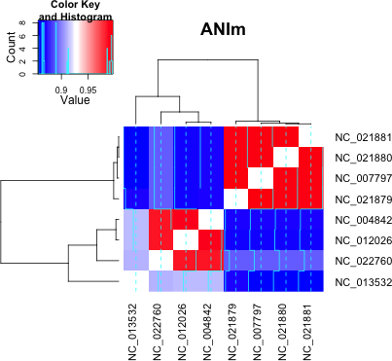
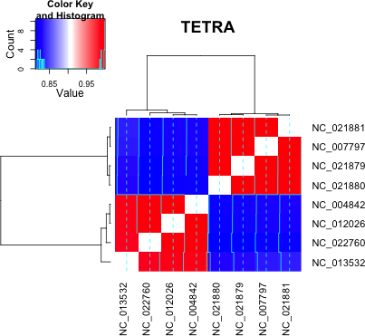
Average Nucleotide Identity (ANI)
ANIb discards useful information that ANIm retains
TETRA reflects bulk genome properties rather than selection on sequence
Data for Anaplasma marginale (3), A.phagocytophilum (4), A.centrale (1)
TETRA scores are prone to false positives; ANIb scores are prone to false negatives

Slide 48
Average Nucleotide Identity (ANI)
Jspecies (http://www.imedea.uib.es/jspecies/)
WebStart
java -jar -Xms1024m -Xmx1024m jspecies1.2.1.jar
Python script
scripts/calculate_ani.py
[ACTIVITY]
average_nucleotide_identity/README.md Markdown
Richter & Rosselló-Móra (2009) Proc. Natl. Acad. Sci. USA doi:10.1073/pnas.0906412106

Slide 49
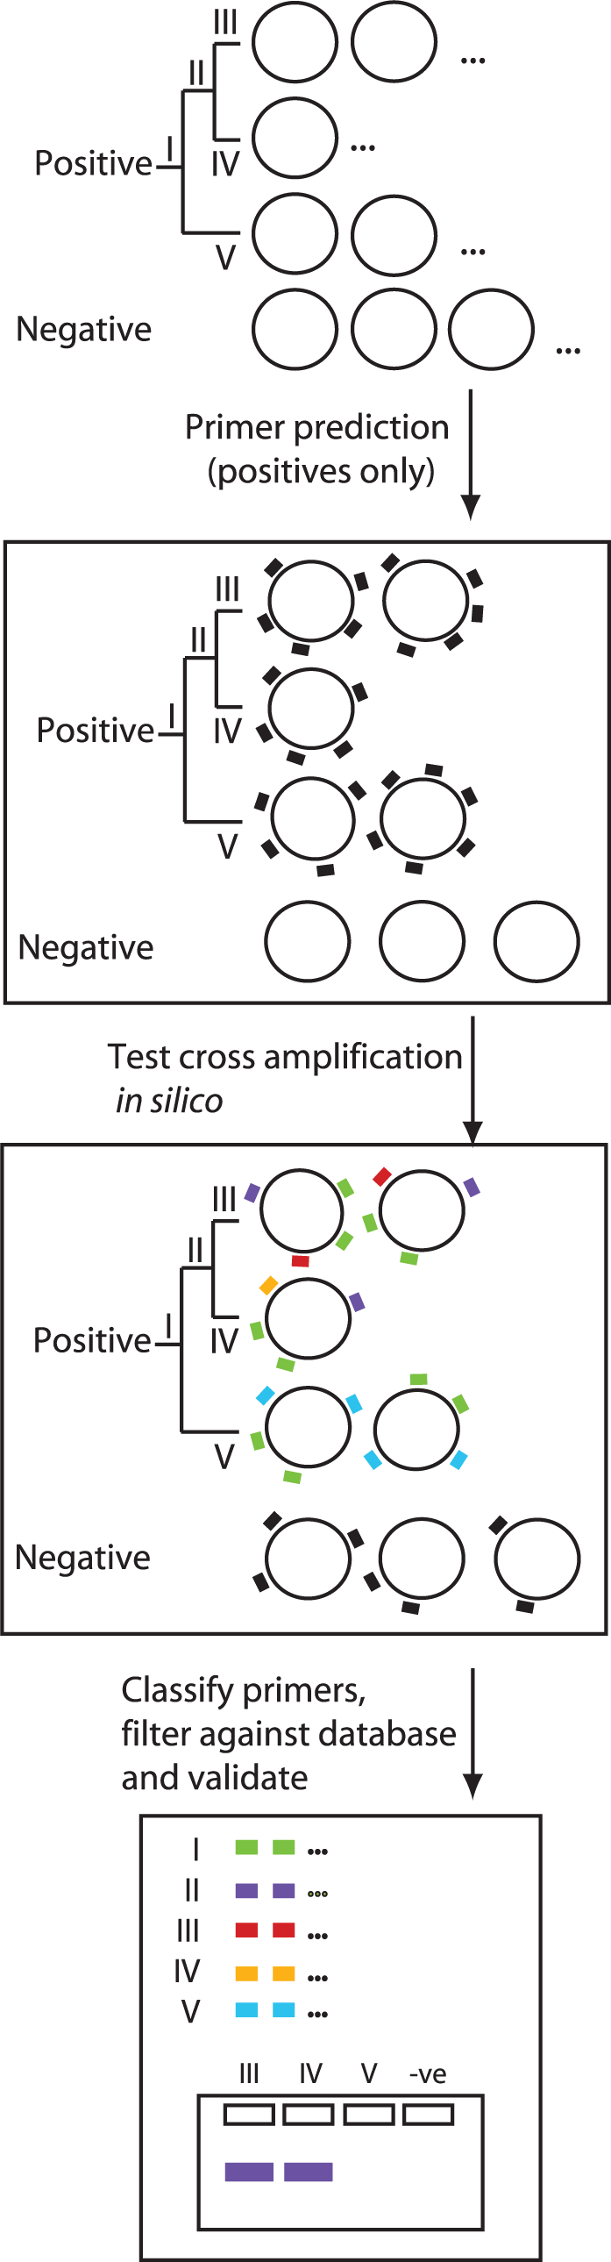
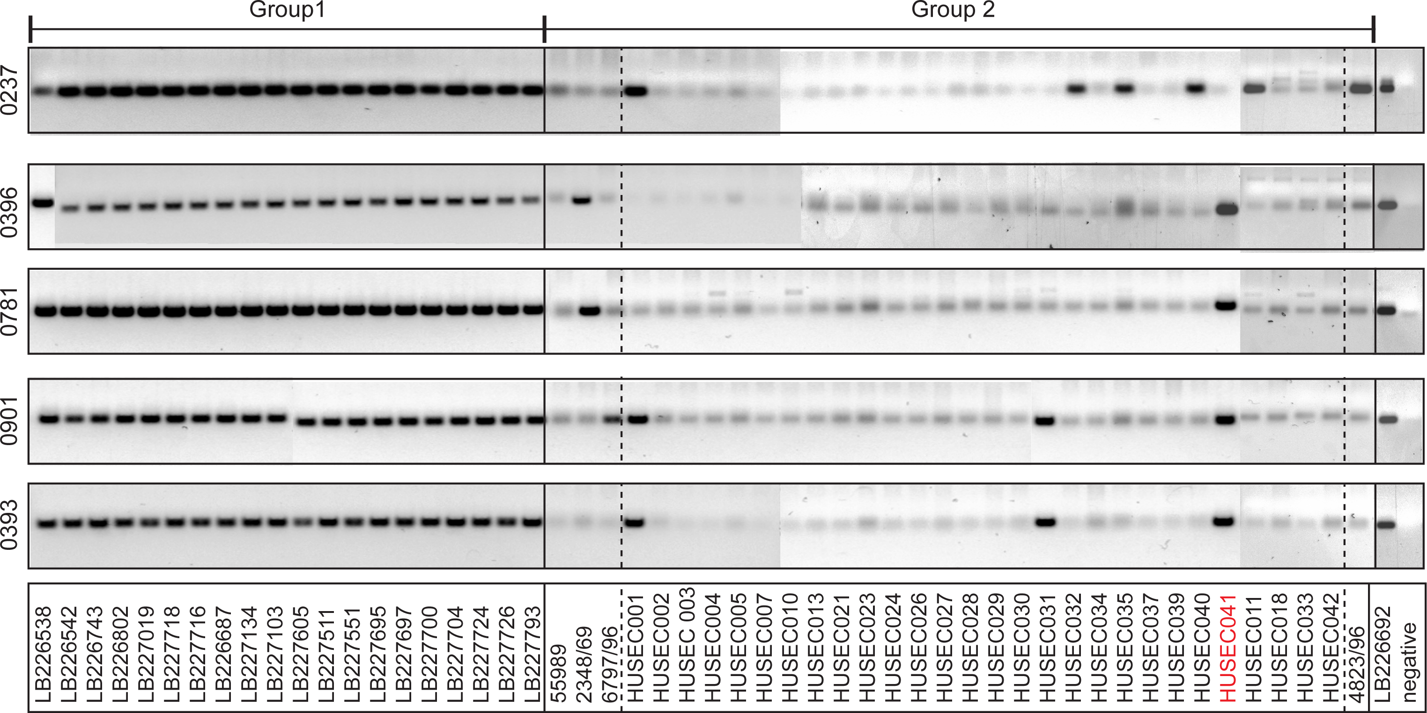
Diagnostic PCR/MLST
PCR/MLST still cheap
(but for how much longer?)
Use whole genomes to identify unique/diagnostic regions for PCR/MLST
Slezak et al. (2003) Brief. Bioinf. doi:10.1093/bib/4.2.133
Pritchard et al. (2012) PLoS One doi:10.1371/journal.pone.0034498

Slide 50
Whole Genome Sequence Comparisons
Comparisons of one whole or draft genome sequence with another (or many others)

Slide 51
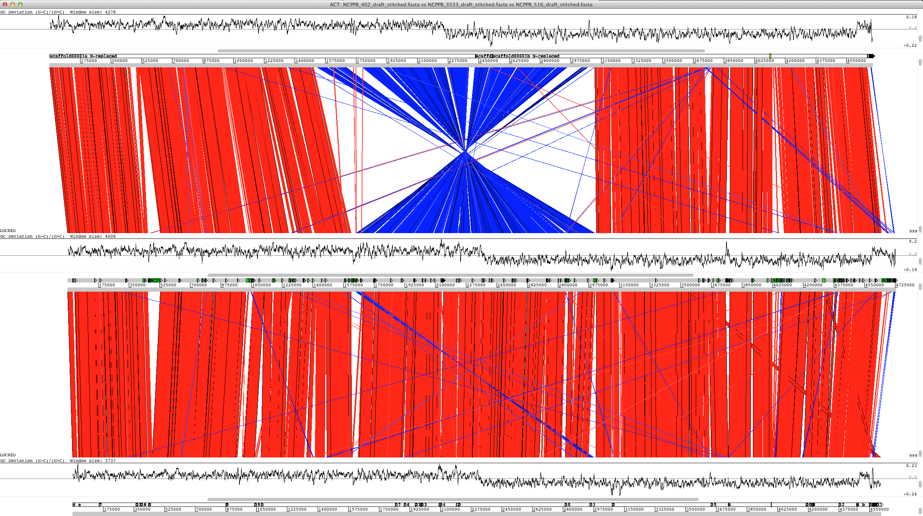
Whole Genome Alignment

Slide 52
Whole Genome Alignment
Which genomes should you align? (or not bother aligning)
For reasonable analysis, genomes should:
derive from a sufficiently recent common ancestor: so that homologous regions can be identified.
derive from a sufficiently distant common ancestor: so that sufficiently “interesting” changes are likely to have occurred
help answer your biological question:
is your question organism or phenotype specific?
are you investigating a process?
This may be more involved for metazoans (vertebrates, arthropods, nematodes, etc.) than prokaryotes…

Slide 53
Whole Genome Alignment
Naïve alignment algorithms (e.g. Needleman-Wunsch/Smith-Waterman) are not appropriate:
Do not handle rearrangements
Computationally expensive on large sequences
Many whole-genome alignment algorithms proposed, including:
LASTZ (http://www.bx.psu.edu/~rsharris/lastz/)
BLAT (http://genome.ucsc.edu/goldenPath/help/blatSpec.html)
Mugsy (http://mugsy.sourceforge.net/)
megaBLAST (http://www.ncbi.nlm.nih.gov/blast/html/megablast.html)
MUMmer (http://mummer.sourceforge.net/)
LAGAN (http://lagan.stanford.edu/lagan_web/index.shtml)
WABA, etc…

Slide 54
Whole Genome Alignment
BLAT
BLAT is broadly similar to BLAST
Main differences:
optimised to find only exact or near-exact matches, for speed
indexes the subject genome, retains the index and scans the query
connects homologous match regions into a single alignment (BLAST reports them separately)
reports mRNA match intron-exon boundaries exactly (BLAST tends to extend)
Advantages: fast; exact exon boundaries; UCSC integration
Disadvantages: does not find more remote/very divergent matches
Kent (2002) Genome Res. doi:10.1101/gr.229202

Slide 55
Whole Genome Alignment
megaBLAST
Optimised for speed over BLASTN (see http://www.ncbi.nlm.nih.gov/blast/Why.shtml):
genome-level searches
queries on large sequence sets
long alignments of very similar sequence (sequencing errors/SNPs)
Uses Zhang et al. (2000) greedy algorithm
Concatenates queries to improve performance (“query packing”)
NOTE: this is good practice for large query sets!
Two modes: megaBLAST, and discontinuous megaBLAST (dc-megablast)
dc-megablast intended for more divergent sequences
Zhang et al. (2000) J. Comp. Biol. 7(1-2) 203-14
Korf et al. (2003) “BLAST”, O’Reilly & Associates, Sebastopol, CA

Slide 56
Whole Genome Alignment
MUMmer
Uses suffix trees for pattern matching: very fast even for large sequences
Finds maximal exact matches
Memory use depends only on reference sequence size
Kurtz et al. (2004) Genome Biol. doi:10.1186/gb-2004-5-2-r12

Slide 57
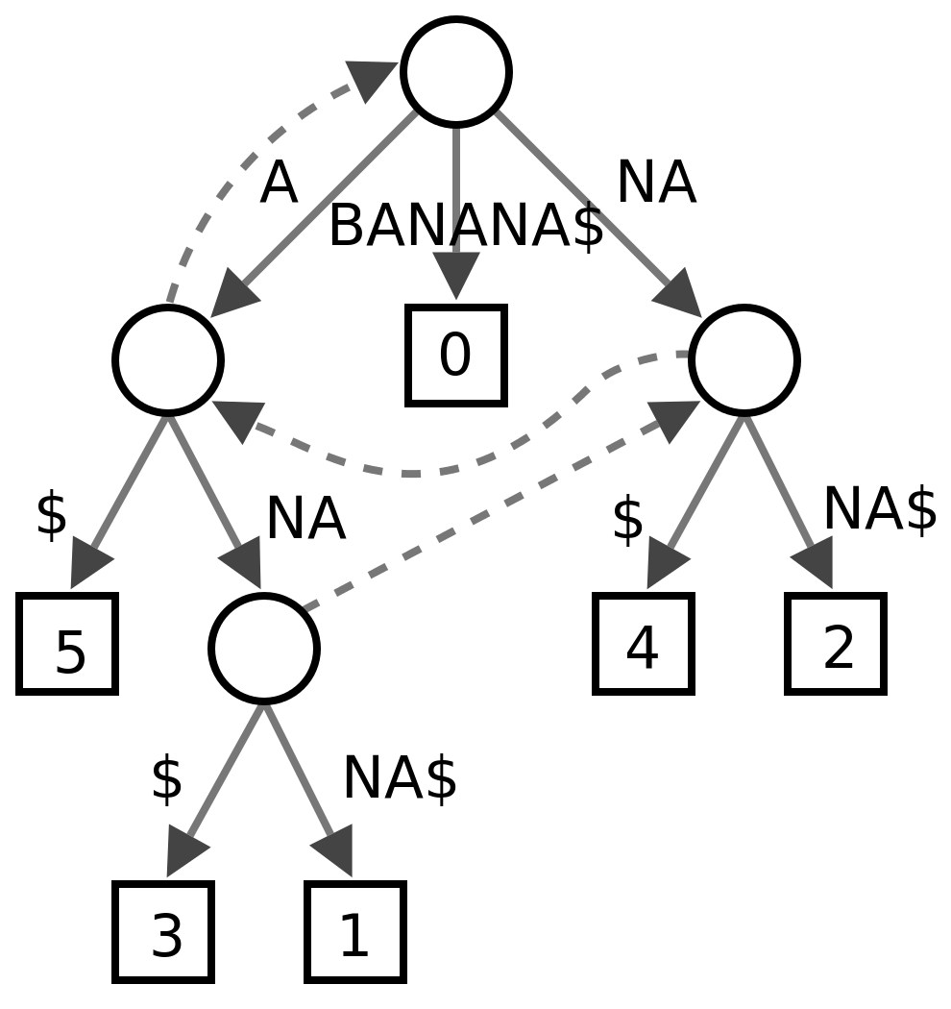
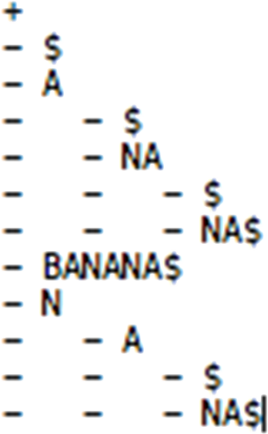
Whole Genome Alignment
MUMmer
Uses suffix trees for pattern matching: very fast even for large sequences
Finds maximal exact matches
Memory use depends only on reference sequence size
Suffix Tree:
Can be constructed and searched in O(n) time
Useful algorithms are nontrivial
BANANA$
B followed by ANANA$ only
A followed by $, NA$, NANA$
N followed by A$, ANA$
Kurtz et al. (2004) Genome Biol. doi:10.1186/gb-2004-5-2-r12

Slide 58
Whole Genome Alignment
MUMmer
Process:
1) Identify a non-overlapping subset of maximal exact matches: often Maximum Unique Matches (MUMs - though not always unique)
2) Cluster into alignment anchors
3) Extend between anchors to produce a final gapped alignment
Very flexible approach: a suite of programs (mummer, nucmer, promer, …)
nucleotide and “conceptual protein” (more sensitive) alignments
used for genome comparisons, assembly scaffolding, repeat detection, etc.
forms the basis for other aligners/assemblers, e.g. Mugsy, AMOS
Kurtz et al. (2004) Genome Biol. doi:10.1186/gb-2004-5-2-r12

Slide 59
Whole Genome Alignment
[ACTIVITY]
whole_genome_alignments_A.md Markdown
https://github.com/widdowquinn/Teaching/blob/master/Comparative_Genomics_and_Visualisation/Part_1/whole_genome_alignment/whole_genome_alignments_A.md

Slide 60
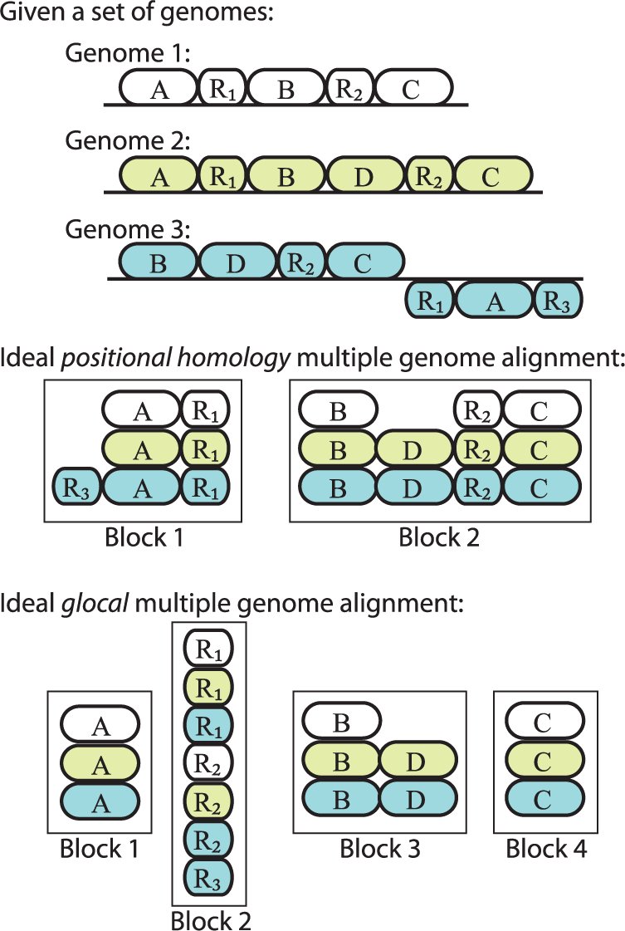
Multiple Genome Alignment
Several tools:
Mugsy (http://mugsy.sourceforge.net/)
MLAGAN (http://lagan.stanford.edu/lagan_web/index.shtml)
TBA/MultiZ (http://www.bx.psu.edu/miller_lab/)
Mauve (http://gel.ahabs.wisc.edu/mauve/)
Positional homology vs. glocal

Slide 61
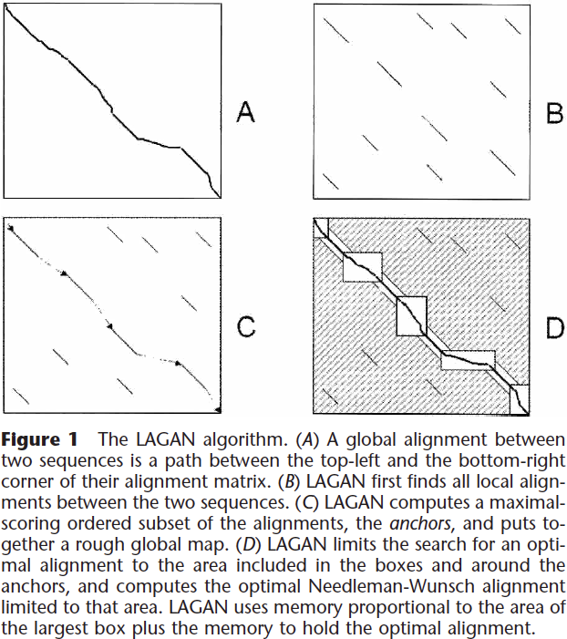
Multiple Genome Alignment
LAGAN: rapid alignment of two homologous genome sequences
Generate local alignments (anchors, B)
Construct rough global map (maximal-scoring ordered subset, C)
Join anchors that lie within a threshold distance, the same way
Compute global alignment by dynamic programming (D)
Brudno et al. (2003) Genome Res. doi:10.1101/gr.926603

Slide 62
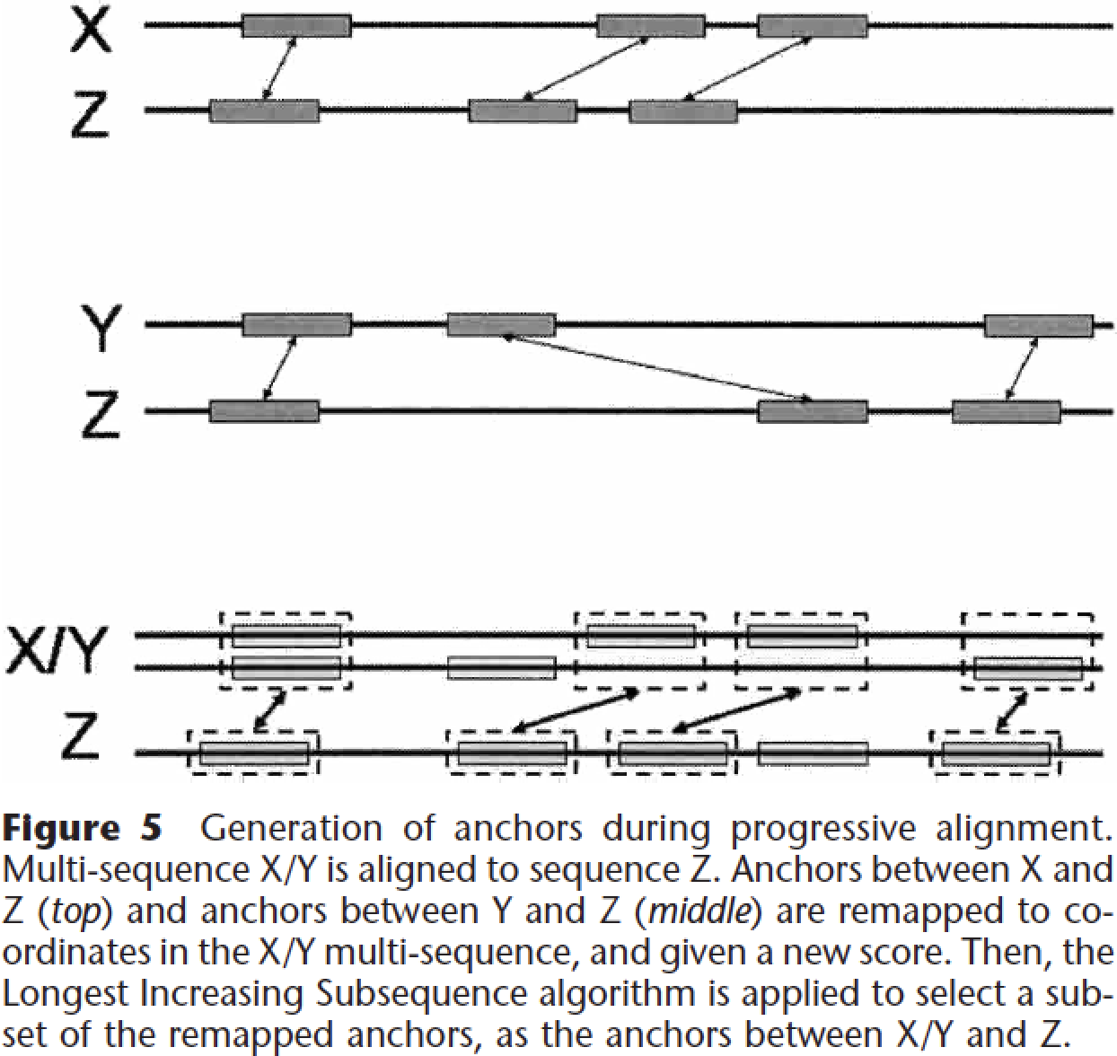
Multiple Genome Alignment
MLAGAN: multiple genome alignment of k genomes in k-1 alignment steps, using a phylogenetic tree (CLUSTAL-like):
Make rough global maps between each pair of sequences (step C in LAGAN)
Progressive multiple alignment with anchors (iterated)
Perform global alignment between closest pair of sequences with LAGAN: alignments are “multi-sequences”
Find rough global maps of this multi-sequence to all other multi-sequences.
Brudno et al. (2003) Genome Res. doi:10.1101/gr.926603

Slide 63
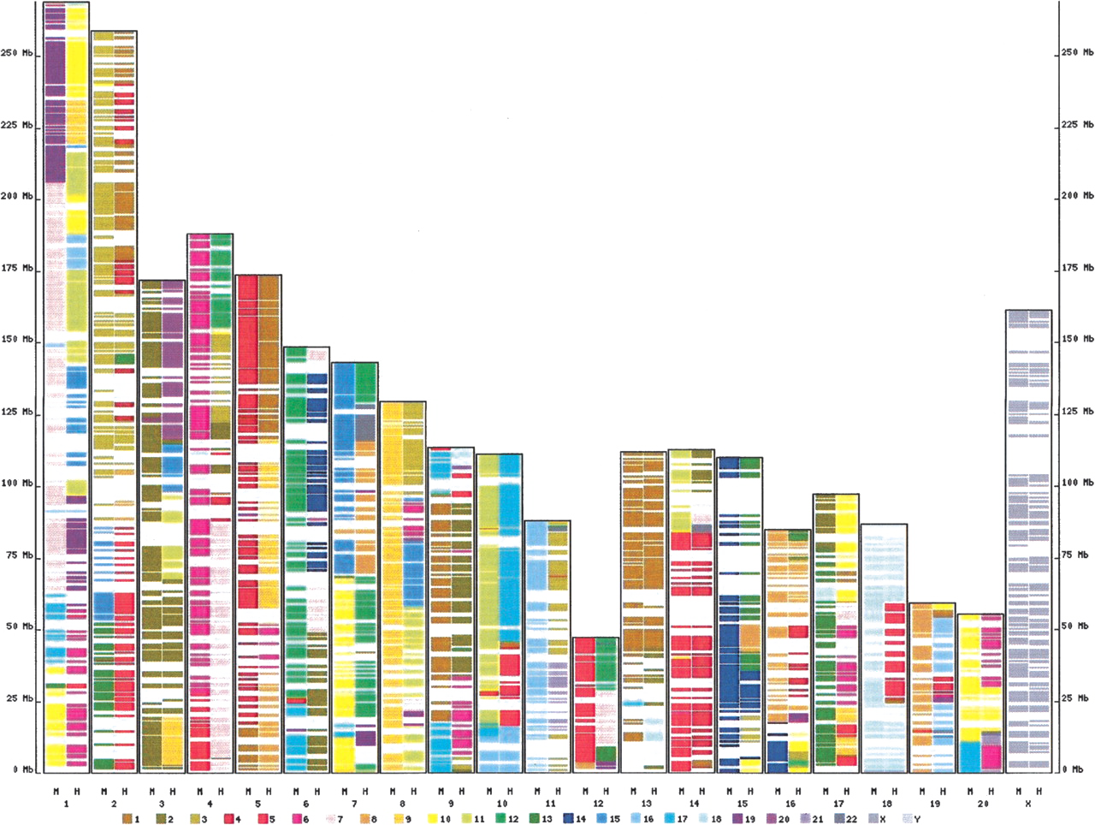
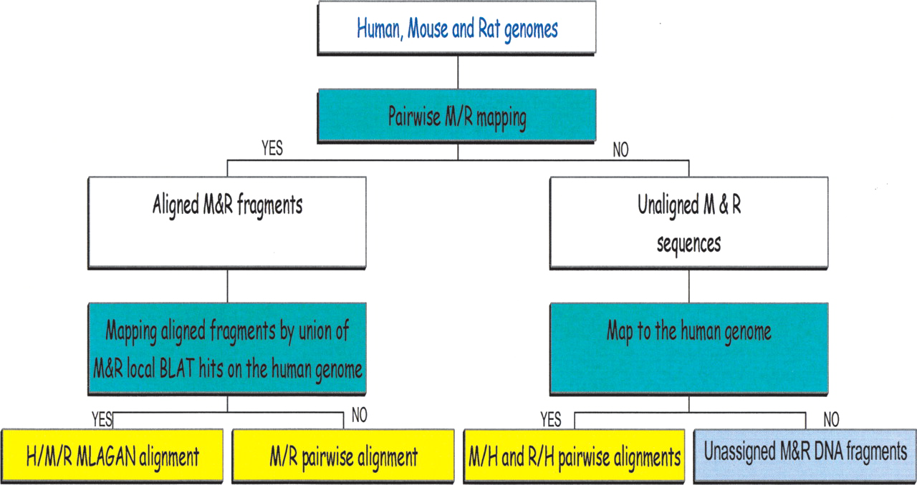
Human-Mouse-Rat Alignment
Three-way progressive alignment, identifying:
Homologous (H/M/R), rodent-only (M/R) and human-mouse or human-rat (H/M, H/R) homologous regions
Three-way synteny
synteny mapped to rat genome
Initial alignments by BLAT
Syntenous regions aligned with LAGAN
Brudno et al. (2004) Genome Res. doi:10.1101/gr.2067704

Slide 64
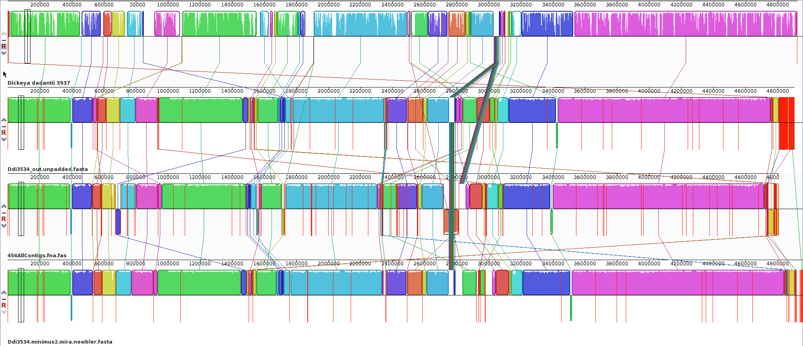
Draft Genome Alignment

Slide 65
Draft Genome Alignment
Whole genome alignments useful for scaffolding assemblies
High-throughput sequence assemblies come in fragments (contigs)
Contigs can sometimes be ordered if paired reads or long read technologies are used
Can also align to a known reference genome
MUMmer
Can use NUCmer or, for more distant relations, PROmer
Mauve/Progressive Mauve
http://gel.ahabs.wisc.edu/mauve/
Darling et al. (2003) Genome Res. doi:10.1101/gr.2289704

Slide 66

Mauve
Mauve’s alignment algorithm
Find local alignments (multi-MUMs – seed & extend)
Construct phylogenetic guide tree from multi-MUMs
Select subset of multi-MUMs as anchors.
Partition anchors into Local Collinear Blocks (LCBs) – consistently-ordered subsets
Perform recursive anchoring to identify further anchors
Perform progressive alignment (similar to CLUSTAL), against guide tree
Mauve Contig Mover (MCM) for ordering contigs
Darling et al. (2003) Genome Res. doi:10.1101/gr.2289704

Slide 67

Mauve
Mauve alignment of LCBs in nine enterobacterial genomes
Rearrangement of homologous backbone sequence
Darling et al. (2003) Genome Res. doi:10.1101/gr.2289704

Slide 68
Draft Genome Alignment
[OPTIONAL ACTIVITY] (useful for exercise)
Alignment and reordering of draft genome contigs
whole_genome_alignments_B.md Markdown
https://github.com/widdowquinn/Teaching/blob/master/Comparative_Genomics_and_Visualisation/Part_1/whole_genome_alignment/whole_genome_alignments_B.md
[ACTIVITY]
Visualisation of whole genome alignment with Biopython
biopython_visualisation iPython notebook

Slide 69
Collinearity and Synteny
Rearrangements may occur post-speciation
Different species still exhibit conservation of sequence similarity and order
Two elements are collinear if they lie in the same linear sequence
Two elements are syntenous (syntenic) if:
(orig.) they lie on the same chromosome
(mod.) conservation of blocks of order within the same chromosome
Signs of evolutionary constraints, including synteny, may indicate functional genome regions
More about this in Part 2, related to genome features

Slide 70

Syntenous
example1.png from biopython_visualisation activity

Slide 71

Nonsyntenous
example2.png from biopython_visualisation activity

Slide 72


Whole Genome Duplication
Puffer fish Tetraodon nigroviridis (smallest known vertebrate genome)
Whole-genome duplication, subsequent to divergence from mammals.
Ancestral vertebrate genome inferred to have 12 chromosomes.
Duplicated genes (ExoFish) on 21 chromosomes
Jaillon et al. (2004) Nature doi:10.1038/nature03025

Slide 73

VISTA, mVISTA, VISTA-Point
Alignment/visualisation tools:
http://genome.lbl.gov/vista/index.shtml
mVISTA: align and compare submitted sequences (up to 2Mbp)
VISTA-Point: visualise precomputed alignments
Frazer et al. (2004) Nucl. Acids Res. doi:10.1093/nar/gkh458

Slide 74

UCSC
http://genome.ucsc.edu/
Many vertebrate/invertebrate model genomes
Kent et al. (2002) Genome Res. doi:10.1101/gr.229102

Slide 75
Conclusion
Physical and computational genome comparisons:
Similar biological questions -> similar concepts
Lots of sequence data in modern biology
Conservation ≈ evolutionary constraint
Many choices of algorithms/analysis software
Many choices of visualisation software/tools
Coming in Part 2: genomic functional elements

Slide 76
Credits
This slideshow is shared under a Creative Commons Attribution 4.0 License http://creativecommons.org/licenses/by/4.0/)
Copyright is held by The James Hutton Institute http://www.hutton.ac.uk
You may freely use this material in research, papers, and talks so long as acknowledgement is made.

Slide 77

Nucleotide Content
A, C, G, T composition
Varies between, and within genomes
staining varies across genomes, due to variation in GC content
“isochores”: regions with little internal GC variation (homogeneous)
long a point of discussion – difficult to define
In humans:
L1, L2 isochores: low GC (≲41%)
H1, H2, H3 isochores: high GC (≳41%)
Imprecise bulk measurement
hybridisation of H3 isochore to human genome
Sadoni et al. (1999) J. Cell Biol. doi:10.1083/jcb.146.6.1211

Slide 78

DNA-DNA Hybridisation (DDH)
Used for taxonomic classification in prokaryotes from 1960s
Sibley & Ahlquist redefined bird and primate phylogeny with DDH in 1980s:
Not without controversy:
Suggestions of data manipulation (see here)
Close evolutionary relationships difficult to resolve due to paralogy (more on paralogy later…)
Still hanging on as a de facto “gold standard” in microbiological taxonomic classification.
Sibley & Ahlquist (1987) J. Mol. Evol. doi:10.1007/BF02111285

Slide 79


Finding isochores
Isochores: homogeneous regions of %GC content
Easy to find with windowed (100kbp) %GC calculation, from sequenced genomes.
3200 isochores characterised in the human genome, consistent with 5 levels (L1, L2, H1, H2, H3) found by staining/hybridisation.
Costantini et al. (2006) Genome Res. doi:10.1101/gr.4910606

Slide 80


Comparative Genomic Hybridisation
Two genomes: “reference” and “test” labelled (red and green), then hybridised against a “normal” genome
semiquantitative:
Red: loss (<2 copies) in tumour
Green: gain (3-4 copies) in tumour
Amplifications (>4 copies) in BOLD
Cases with the same Copy Number Aberration (CNA) are numbered
De Bortoli et al. (2006) BMC Cancer doi:10.1186/1471-2407-6-223

Slide 81


Array Comparative Genomic Hybridisation
Early approaches took a threshold score (present/absent)
Later approaches used known reference genome sequence context (HMMs, synteny) to improve presence/absence calls
No hybridisation = “absent” or“divergent”?
Not nearly as good as sequencing directly!
Pritchard et al. (2009) PLoS Comp. Biol. doi:10.1371/journal.pcbi.1000473

Slide 82


k-mer Spectra
k-mer spectrum:
CpG suppression (CGs are uncommon in vertebrate genomes), but (by simulation) only when in combination with a particular %GC, explains multimodality
Chor et al. (2009) Genome Biol. doi:10.1186/gb-2009-10-10-r108

